Slide 1
Image Creation
Technical details and full process
Choice of imaging function
Choice of color scale
Choice of resolution

Slide 2
Some remarks
This presentation is made to compare in between different ways to create images from our data.
I will compare the 3 functions in Python’s Matplotlib I tested.
I will also compare different color scales and different resolutions of the images.
This presentation is made to document the effort invested into image creation – especially to ease any adaptations to the image style in the future! Feel free to look at the comparisons and share your thoughts!
This is not intended to be a code documentation, but some parts of my code will be explained here. However, I will not introduce all classes or functions I use in my code (as this is not needed for the understanding).
For further detailed explanation of the plotting functions consult Matplotlibs (“Mpls”) documentation: https://matplotlib.org/stable/

Slide 3
Details Image creation - overview
What we get:
Different measurement positions from array geometry and/or array translation assigned with a signal.
What is made from this:
Necessary data treatment like background subtraction and response normalization before image creation.
Positional information is collected and merged into one numpy array (which needs to have a rectangle shape mxn)
If two values are given for one position, I calculate the mean (except if one value is zero - other criteria might be added here)
Further oversampling is not considered in this step
Values not given (to have a rectangle shape) are set to “-1”
The map might undergo further processing
e.g. replacing not working pixel
dealing with oversampling (which needs to be recognizable from the given info about diode geometry and/or translation -> if image pixel_size < measurement diode_size)
The image is plotted with Matplotlib (note that the image info could also be exported/saved in any image format)

Slide 4
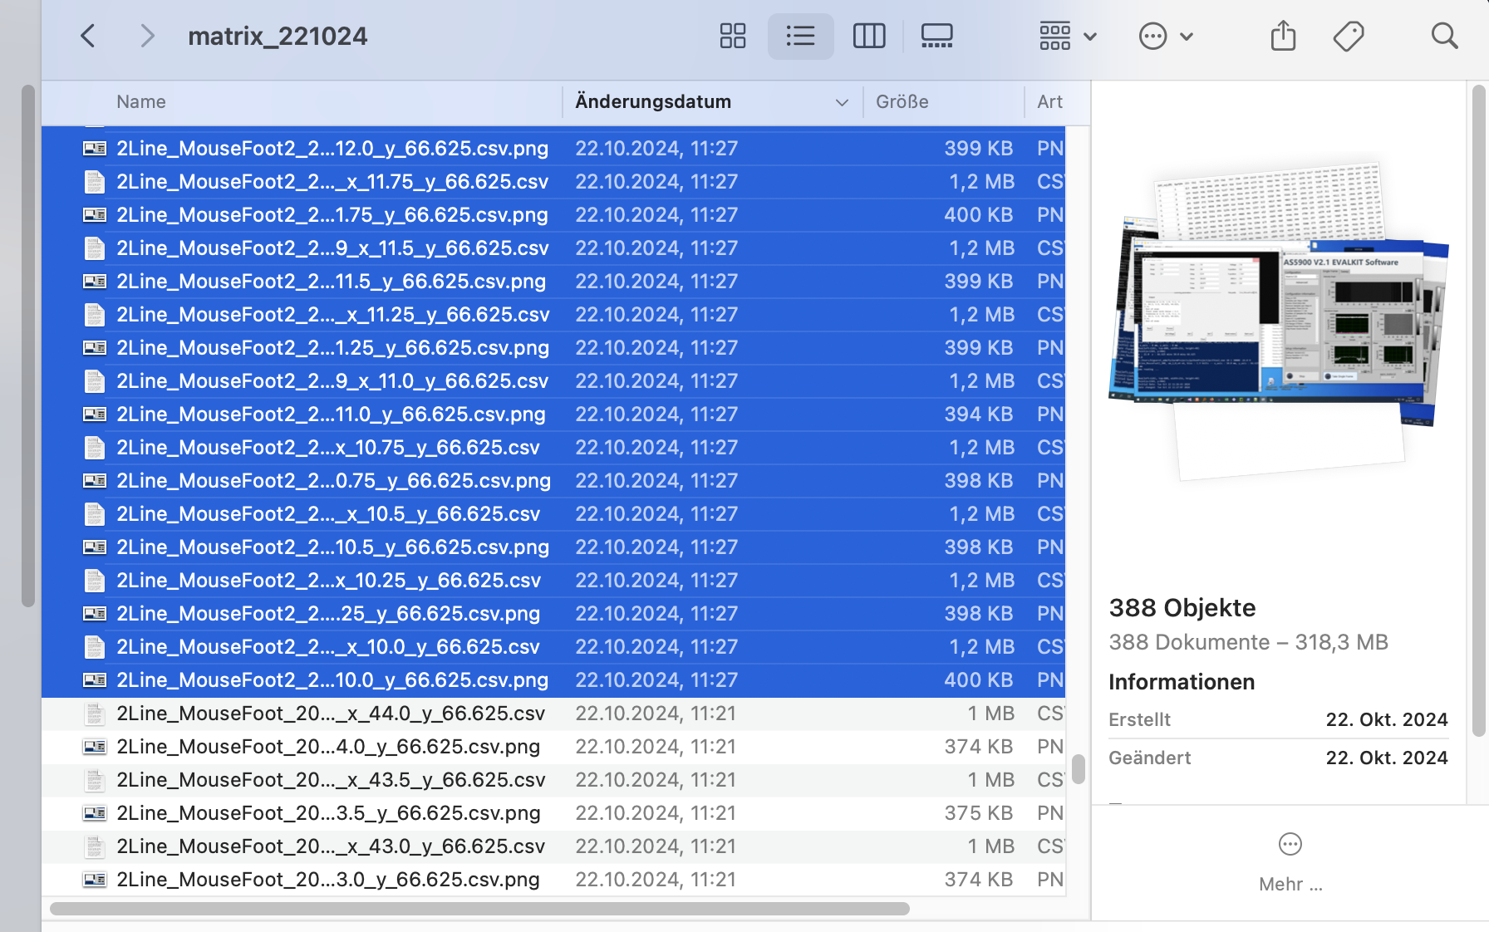
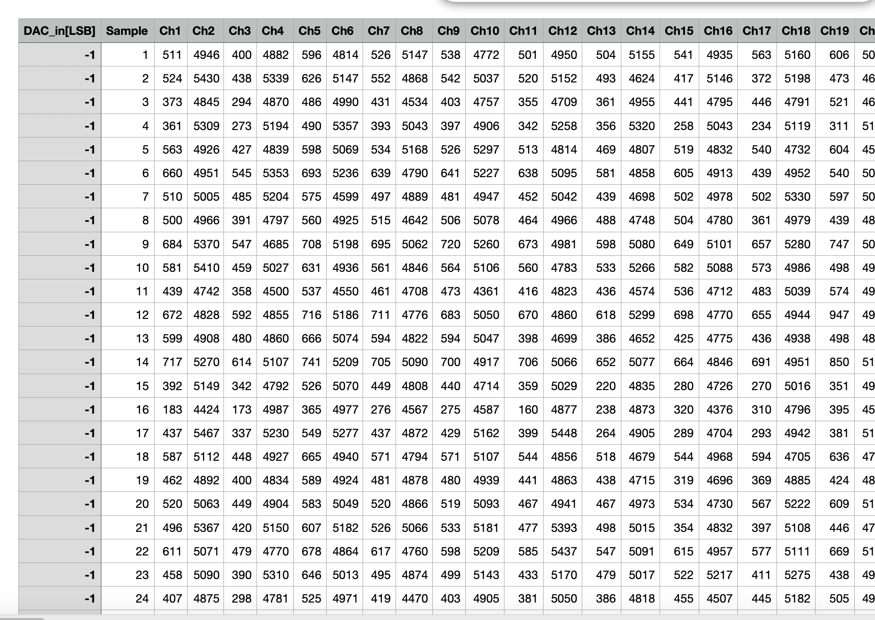
What we get from measurements

Slide 5
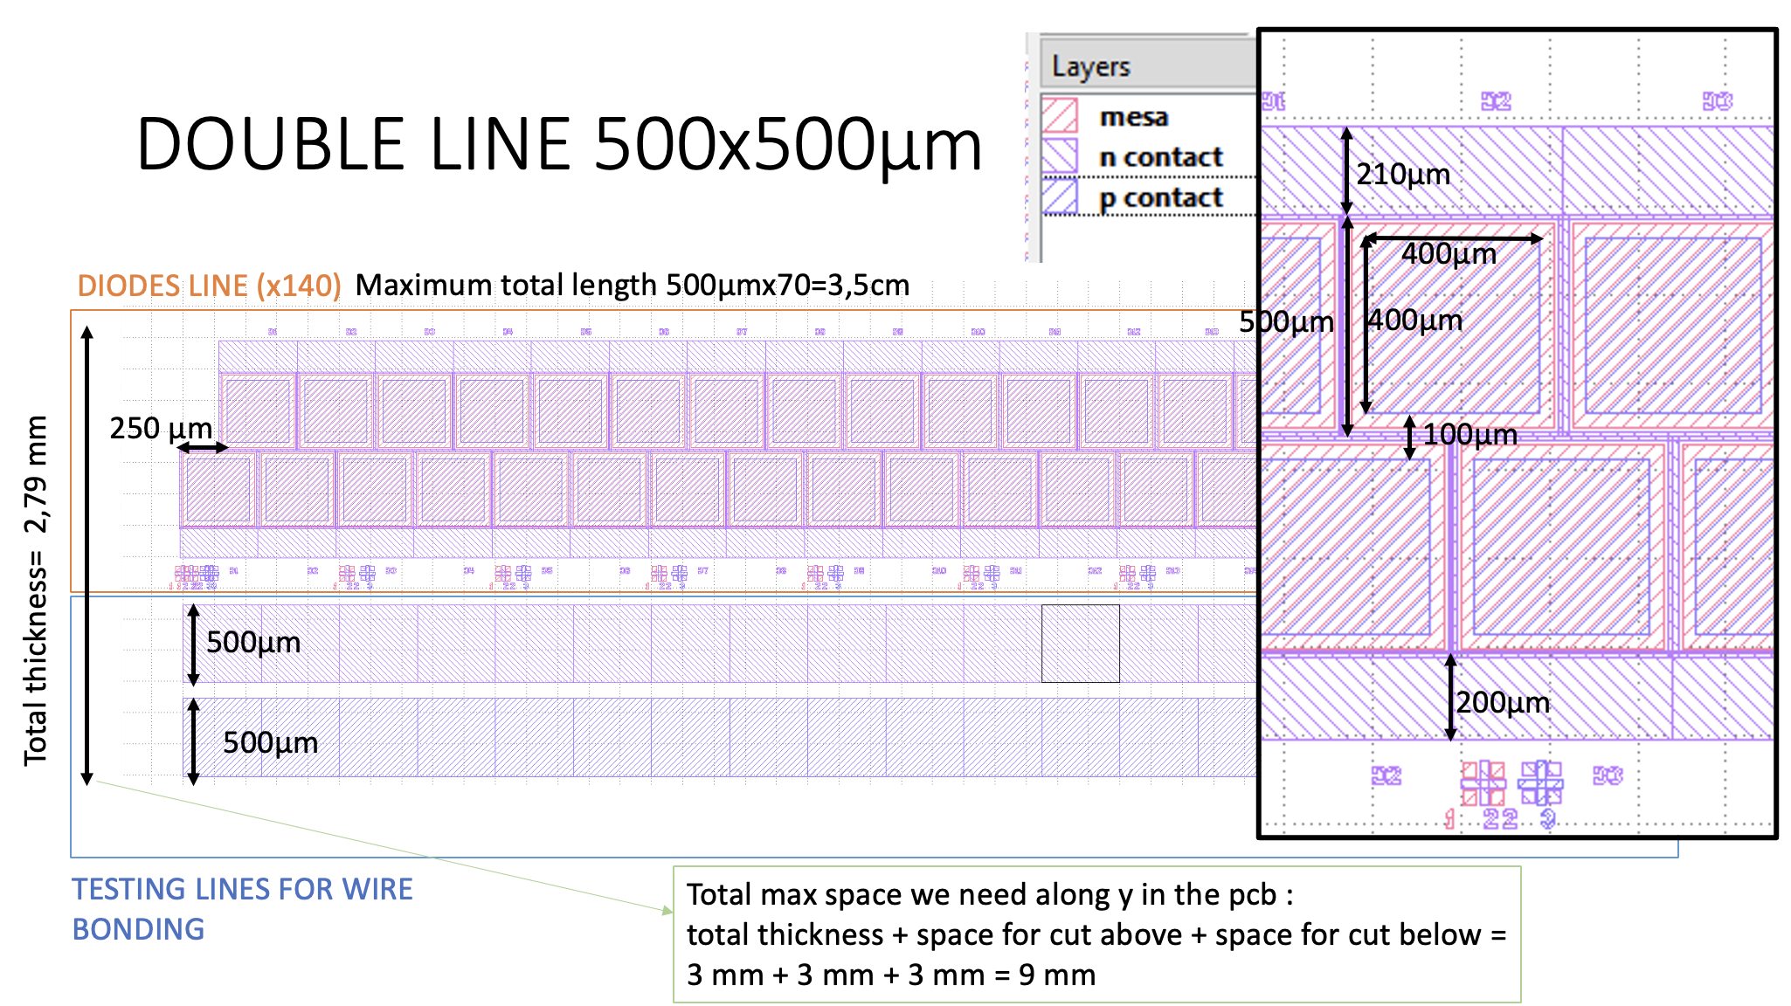
What is needed to generate an image
Ch 1
Ch 2
Ch 3
Translation
Ch 4
…
Geometry and
channel assignment
+

Slide 6
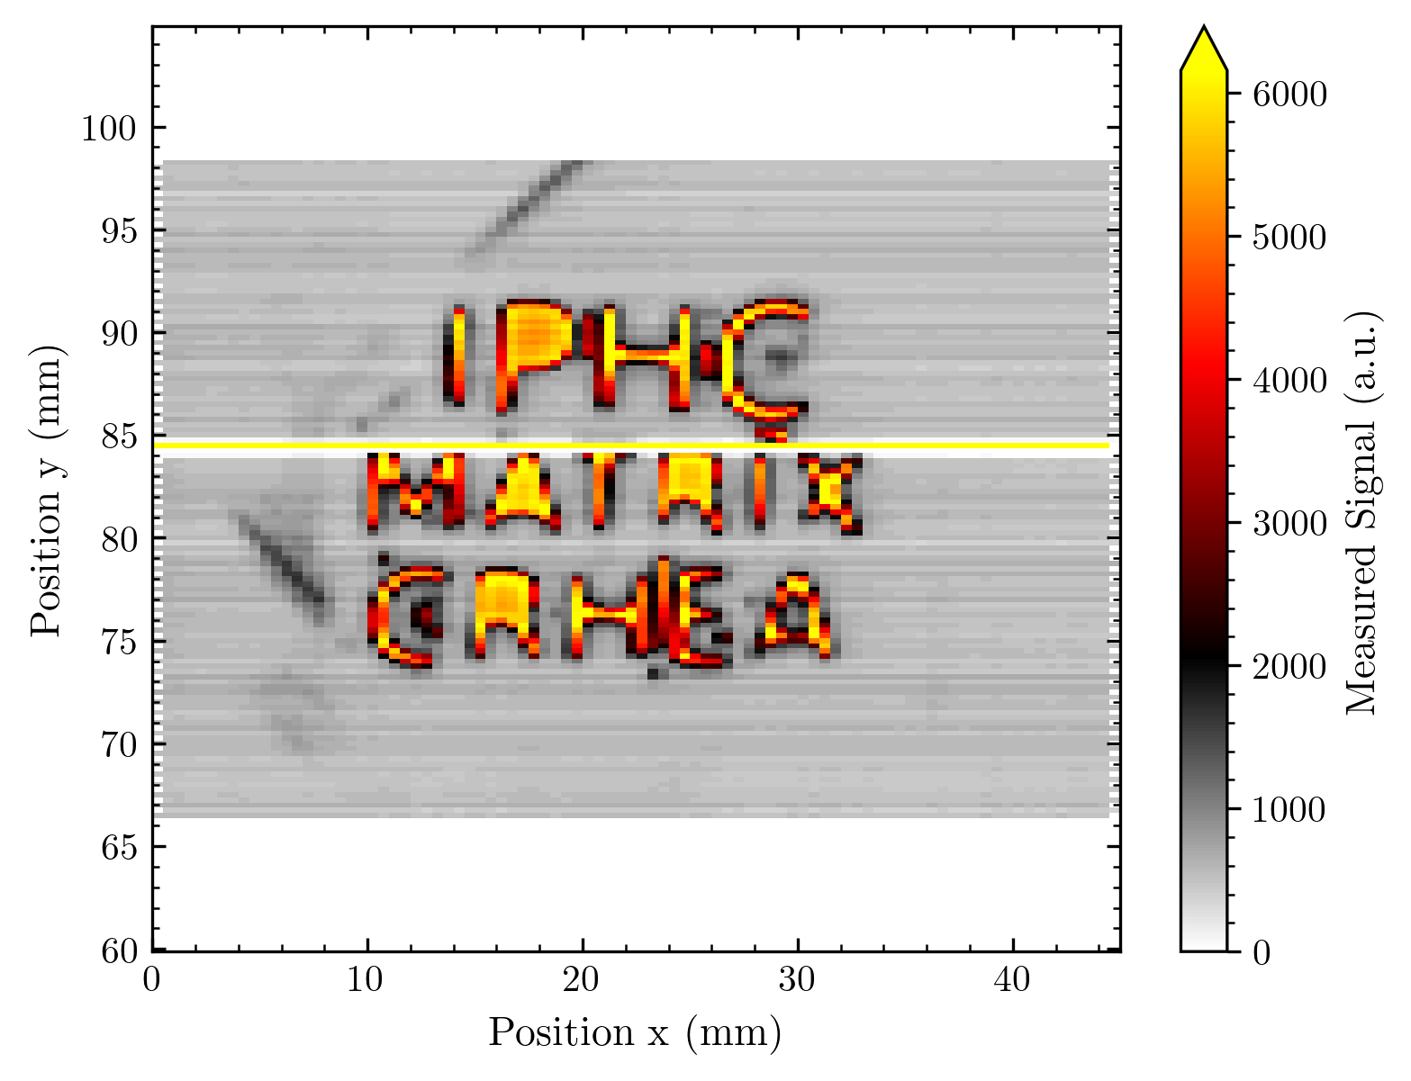
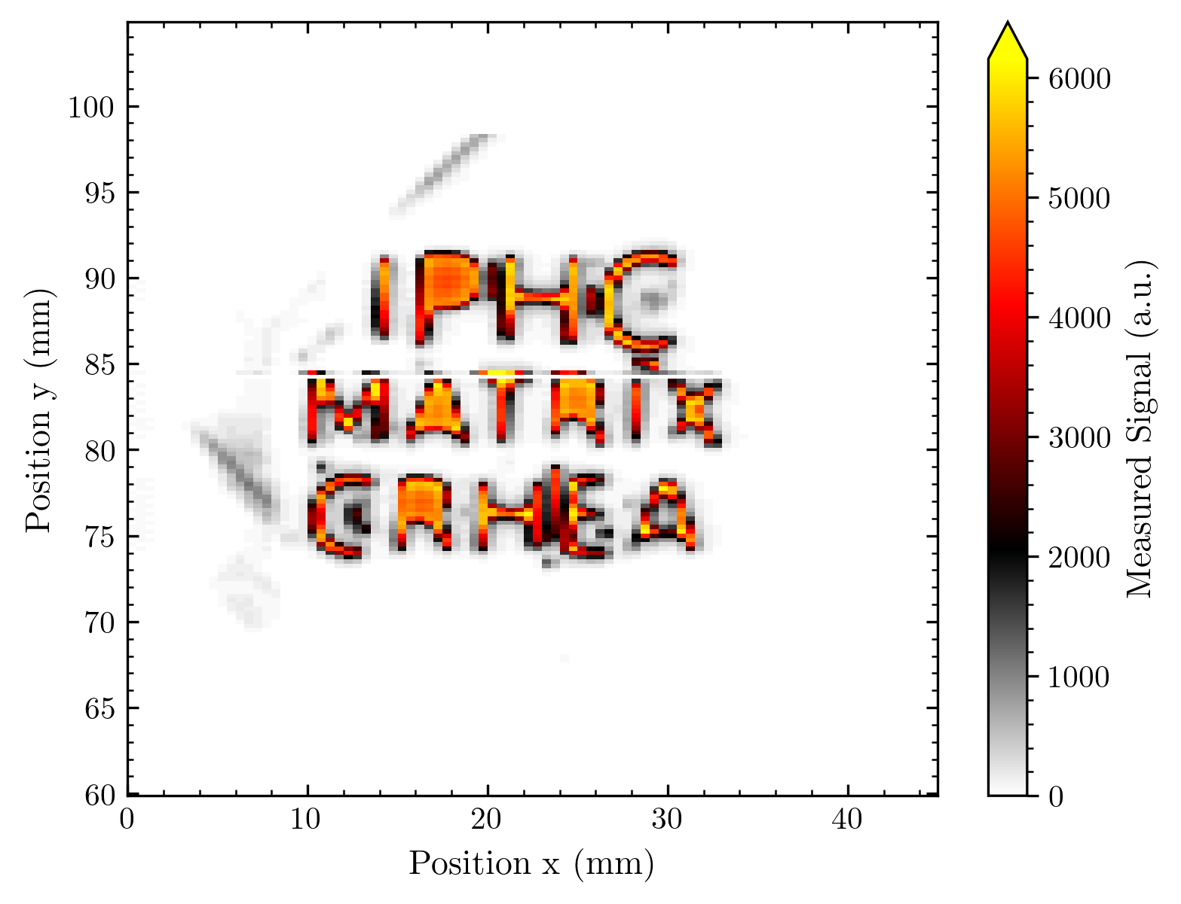
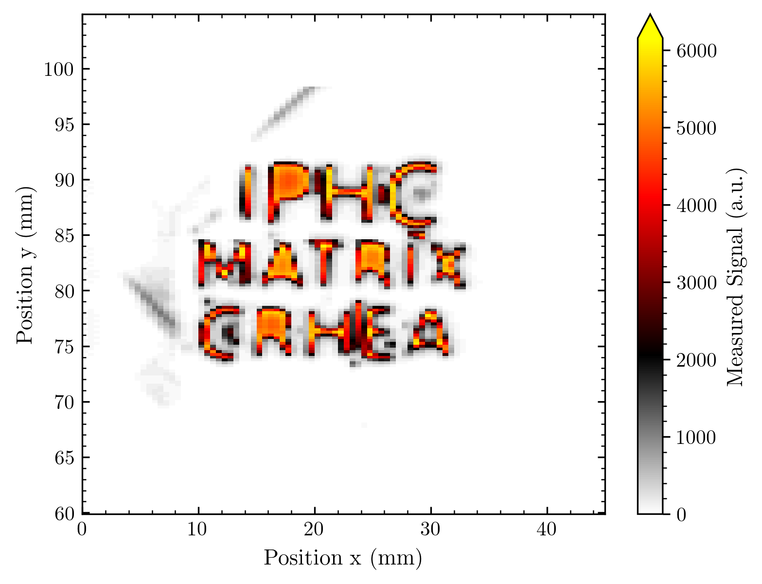
Data treatment (not necessary to get an image, but mandatory to get meaningful results)
(Imported) Data file level:
One or multiple background measurements that are subtracted
Normalization of diode response homogeneity
Image level:
Further treatment (compensation, oversampling, etc.)
Image after normalization and
compensation of not working diode
Raw data image
Image after background subtraction

Slide 7
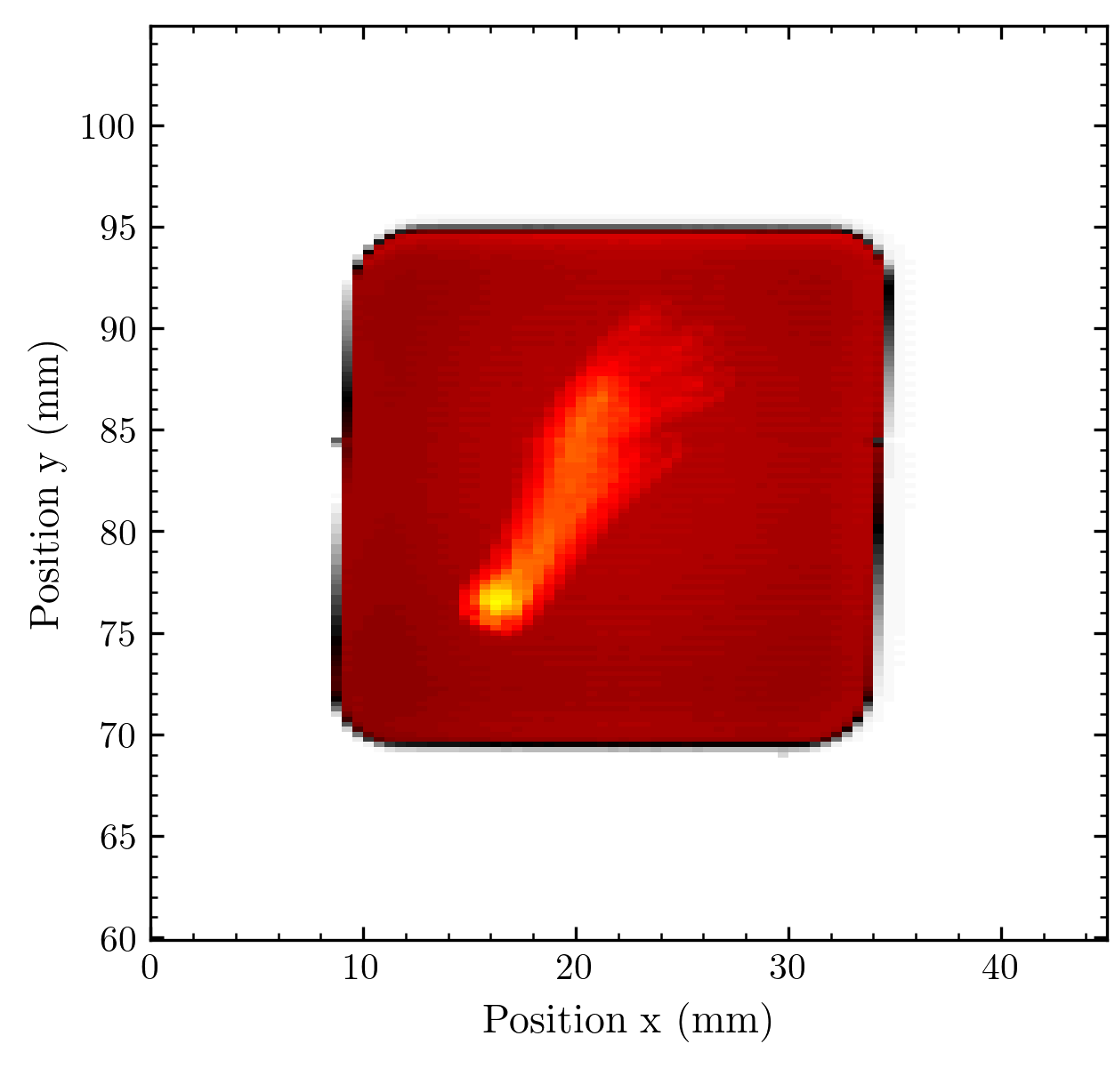
Generation of an image
e.g. stage Position x = 12 (and x = 12.5)
Translation
Ch 128
Ch 127
Ch 126
Ch 125
…
e.g. Diode channel 30 of 128
Geometry and
channel assignment

Slide 8
How diode geometry is considered
Channels in .csv files need to be assigned to the correct diodes in the array; there can be (and is) some mapping between the readout and the diode array.
This is considered by the readout module chosen. (Compare examples in my code)
After reading the .csv file, the data is stored in an array resembling the shape of the array.
Geometry is specified globally for one readout class (“Analyzer”), handed are diode_dimension, diode_size, diode_spacing, diode_offset.
For the schematic on the right side Analyzer is initialized as following:
diode_dimension = (2, 64)
diode_size = (0.4, 0.4), diode_spacing = (0.1, 0.1)
The offset is given by the extra parameter diode_offset – [array_as_shape_diode_array[0], array_as_shape_diode_array[1]]
diode_offset = diode_offset = [[0, -0.25], np.zeros_like(64)]
With the geometry on the right schematic, the array has the shape (2, 64).
When assigning the signal to a global image position, the following is calculated (with pos the parsed position from the translation stage) – i, j sum over the diode_dimension (here i = 0-1, j = 0-63)
x.append(pos[0] + (i - (self.diode_dimension[0]-1)/2) * (self.diode_size[0] + self.diode_spacing[0]) + self.diode_offset[1][j]) y.append(pos[1] + (j - (self.diode_dimension[1]-1)/2) * (self.diode_size[1] + self.diode_spacing[1]) + self.diode_offset[0][i])
The position of the diode as i * (diode_size + diode_spacing) - with the array centered i -> i - (self.diode_dimension[0]-1)/2 in the stage position- is added/subtracted from the stage position.
Ch 128
Ch 127
Ch 126
Ch 125
…

Slide 9
Process of image creation
Step 1 Iteration over each measurement file:
Convert the measurement channel to the diode
Convert the diode geometry into positional info
Parse the stage position from the file name
There are max. 128 signals in one file (with 1 stage position but possibly 128 different x/y combinations from diode geometry)
I now have pairs of (x|y|signal) for all measurement points
Step 2 Iteration over x and y positions:
Get all unique positions from x and y information (set)
Create one rectangle array filled with placeholder “-1” (next slide) and following properties:
Minimum, maximum = min of x and y, max of x and y
Number of columns = number of different x positions
Number of columns = number of different y positions
Step 3 Iteration over all combinations (x|y|z):
Sort each combination into its array cell
I have one 2D array filled with the signals and two 1D arrays assigning the x / y coordinate to each point in the 2D array
y
x

Slide 10
Placeholder
If e.g. the yellow marked position are not given in the measurements, their value is “-1”
Why “-1” as this placeholder?
My color scaling starts usually at 0, so I do not want to assign any value > 0.
I want a value that can be distinguished from 0 signal diodes
None, np.nan etc. are not working for image generation
Why this choice could be inconvenient:
If a subtracted signal is -1 (possible) it is recognized as a placeholder and not as a signal.
This is only relevant if there are multiple values for this one pixel which might be interpolated. (next slide)
Why not using np.nan and afterwards replace np.nan with e.g. “-1”? One more iteration over each map!
Do you have better ideas for this?
-1 |  |  |  |  |  |  |  |  | -1
-1 |  |  |  |  |  |  |  |  | -1

Slide 11
Interpolation?
Situation: There are overlapping positional information (and thus more than 1 signal for one array cell)
[This can be an intended or no-intended consequence of multiple measurements or array geometry and translation choice]
Precision of the code:
Step 3 Iteration over all combinations (x|y|z) with option ”fast” interpolation:
If cell == -1:
Cell = Signal
elif cell == 0:
Cell = Signal
elif signal == 0:
continue
else (cell != -1 & cell != 0 & signal != 0):
Cell = (Cell + signal) / 2
This is ok for 2 overlaps. If we ever produce more overlaps another interpolation option needs to be implemented to verify:
Mean cell = Sum signals / # signals

Slide 12
Conventions
The length scale of all images is mm. Thus, the stage position needs to be parsed as mm and the diode geometry must be specified in mm.
The rows of the array correspond to the y coordinates and the columns to the x values.
The array is indexed as Array[row, column] meaning the y-coordinate is passed as the first index, then second the x-index
⚡️In the rest of my code I picked a different convention: X and Y positional information is given in alphabetical order.
E.g. when assigning the dimensions of the diodes the information is passed as (x_length, y_length).
I will not change the convention because either way the array indexing or the geometry specification would contradict the user intuition. Just be aware of this!
The channels are sorted as: Ch1 is on the bottom of the image, Ch128 on the top. In our measurements this is usually inverted, thus the images can be inverted by an option
invert=[x_invert: bool=False, y_invert: bool=False]
It might be wise to choose a mandatory assignment for measurements to avoid complications with the specification of this inversion and diode geometry!
y
x

Slide 13
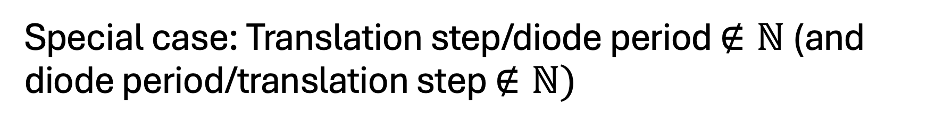
Special case: Translation step/diode period $∉ℕ$ (and diode period/translation step $∉ℕ)$
Means we have picked a step size (or diode geometry) that is not a multiple of the diode period (or vice versa).
The consequence is: The pixel sizes become inhomogeneous. This has implications for the image generation and the usage of super-resolution.
Example: 2x2 array with 0.5 mm diode period in each dimension
3 steps in x-direction around the center (50, 50) mm.
Step size = 2 mm
Step size = 0.25 mm
Step size = 1.125 mm

Slide 14
1. Translation step size = 1 mm
Step 1
Step 2
Step 3
Outcome: Homogeneous pixels with 0.5x0.5 mm size (and some unfilled pixels in between)

Slide 15
2. Translation step size = 0.25 mm
Step 1
Step 2
Step 3
Pixel Grid
Outcome: Homogeneous pixel size 0.25x0.5 mm size
Without deconvolution, we have oversampling at the overlapping pixels.
The options are Deconvoluting the array to use the overlap information or just assigning one of the signals to the now smaller pixels

Slide 16
3. Translation step size = 1.25 mm
Step 1
Step 2
Step 3
Outcome: Inhomogeneous pixels with 0.5x0.5 mm size at the borders and 0.25x0.5 mm size in between. Only four deconvoluted pixels would contain overlap information.

Slide 17
Final remarks on this process documentation
If you think that any part of this process could be done better / should be done differently – pls let me know!
Computation time is a thing here – but for the array sizes we generate not a problem (time scale < 1 s)
Limits in computation time come from reading in multiple .csv files and sorting the data into a big dictionary (time scale = 1 s)
With different readout circuits, the reading of separate .csv files hopefully becomes obsolete – and the data can directly be processed with (in the easiest case, maybe not most efficient case) Python

Slide 18
How the image is plotted
So far, I have created 3 arrays: x, y, z forming one image with shape(z) = (shape(y), shape(x))
This data tuple is an image – but I call it a “map” in my code since it’s not visualized yet and not in any image standard format
This image can be further processed, exported (so far only for other Python processes) or plotted
To plot the image some external plotting library is needed. I use Matplotlib (the most convenient Python tool for creating static 2D plots I am aware of).
Still, there are several tools for creating a plot out of this image data in Matplotlib – depending on how the image data is interpreted and handed.
I will present the three most useful tools I tested and used.

Slide 19
Matplotlibs Contourf
Takes coordinates as [X, Y] (X, Y from my image generation can be directly inserted as coordinates)
Takes values assigned to coordinates as Z: (len(y), len(X)): array-like (exactly the Z array from my image generation)
Needs some levels in the signal values where contours are plotted.
Colors orient on minimal and maximal values to specify.
Functionality: Assign data values to coordinate points, interpolate in between the points, estimate contour lines corresponding to a data value level (= mpls “contour”), fill the contour with an assigned color map color (contour + filled = “contourf”)

Slide 20
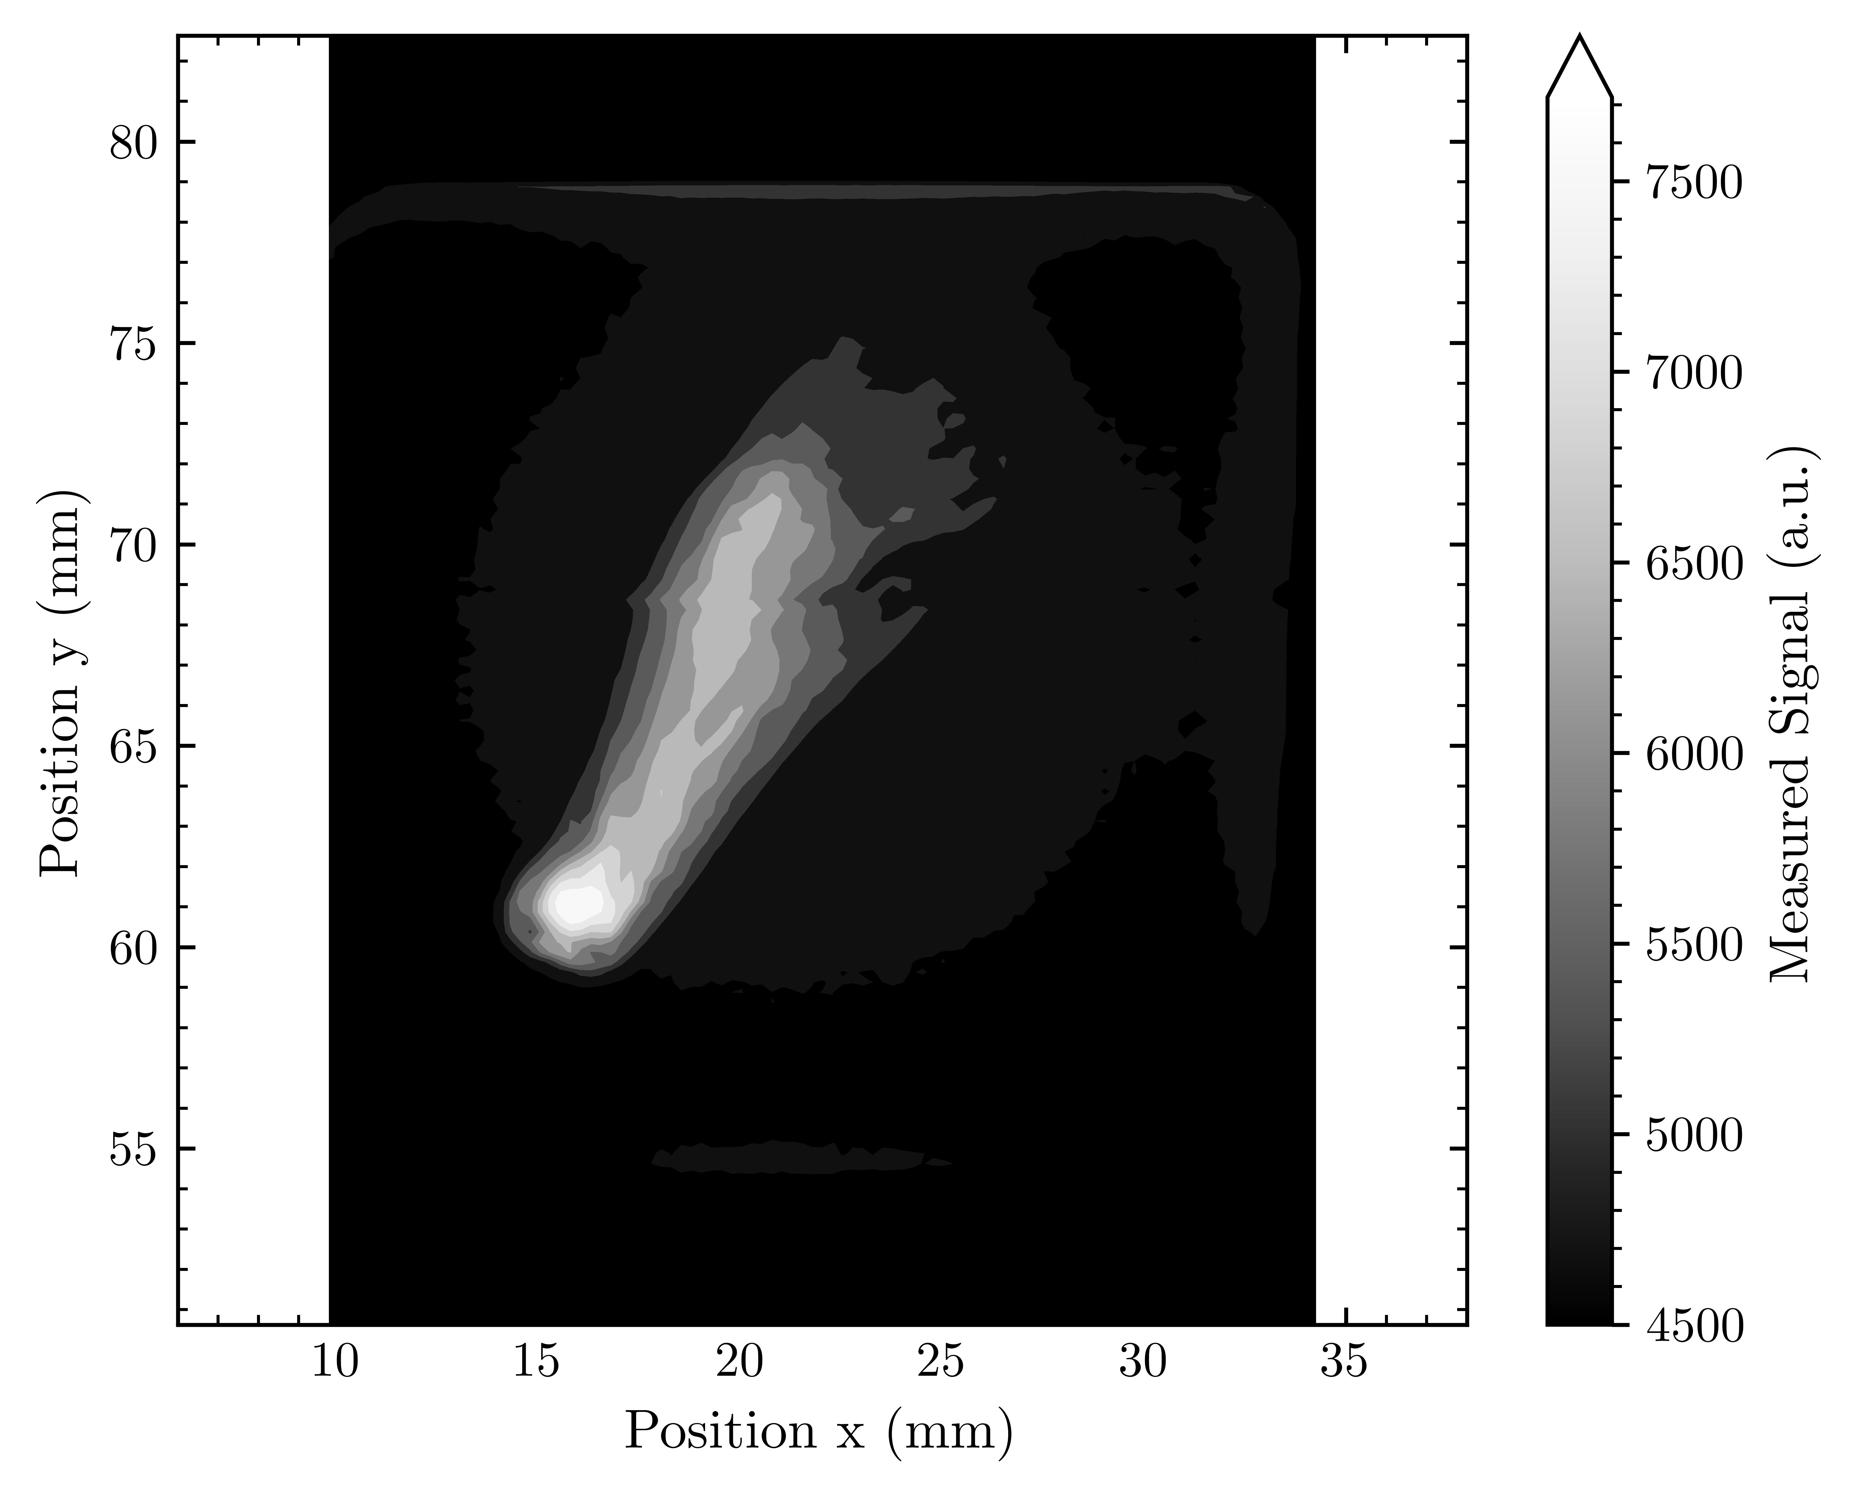
How contourf looks
(I usually have more levels, to illustrate the concept I throw away signal information here - 10 colour levels only)

Slide 21
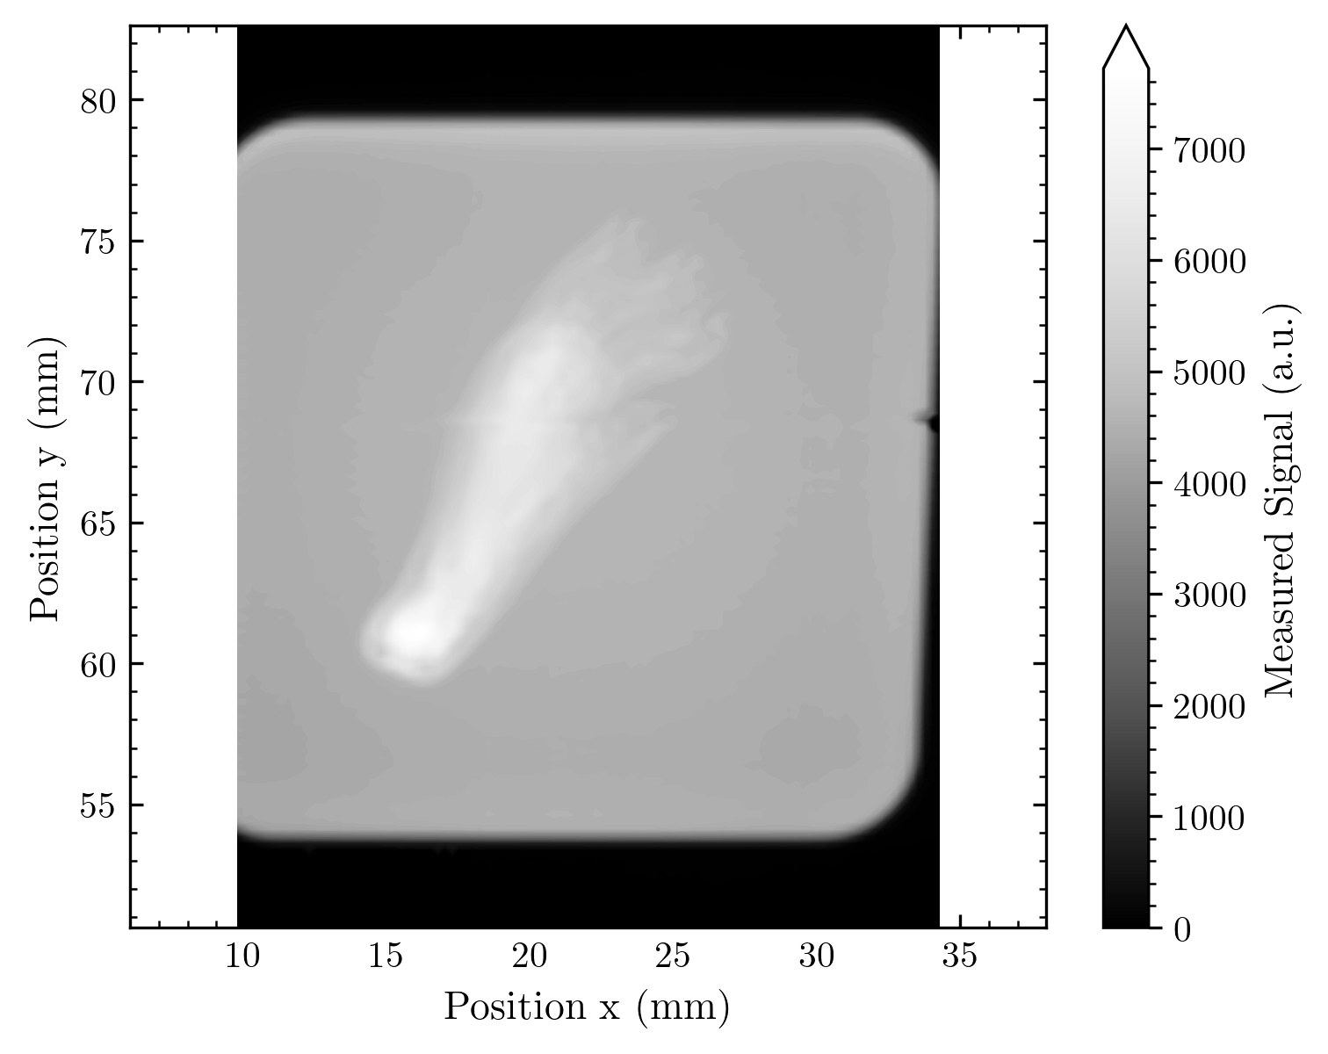
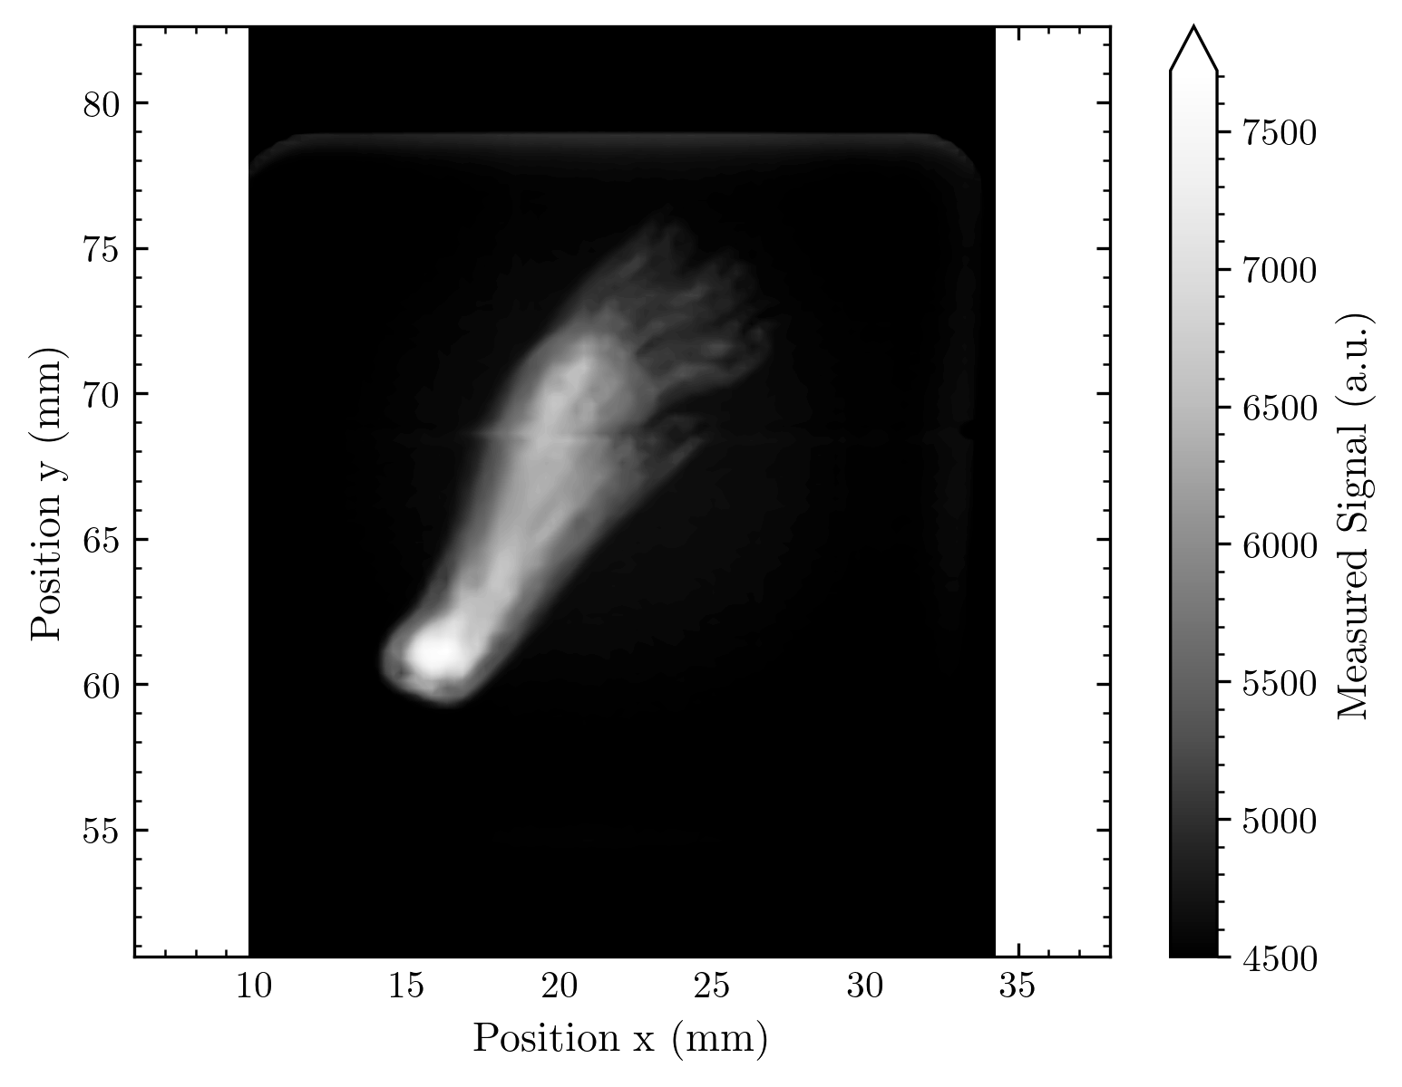
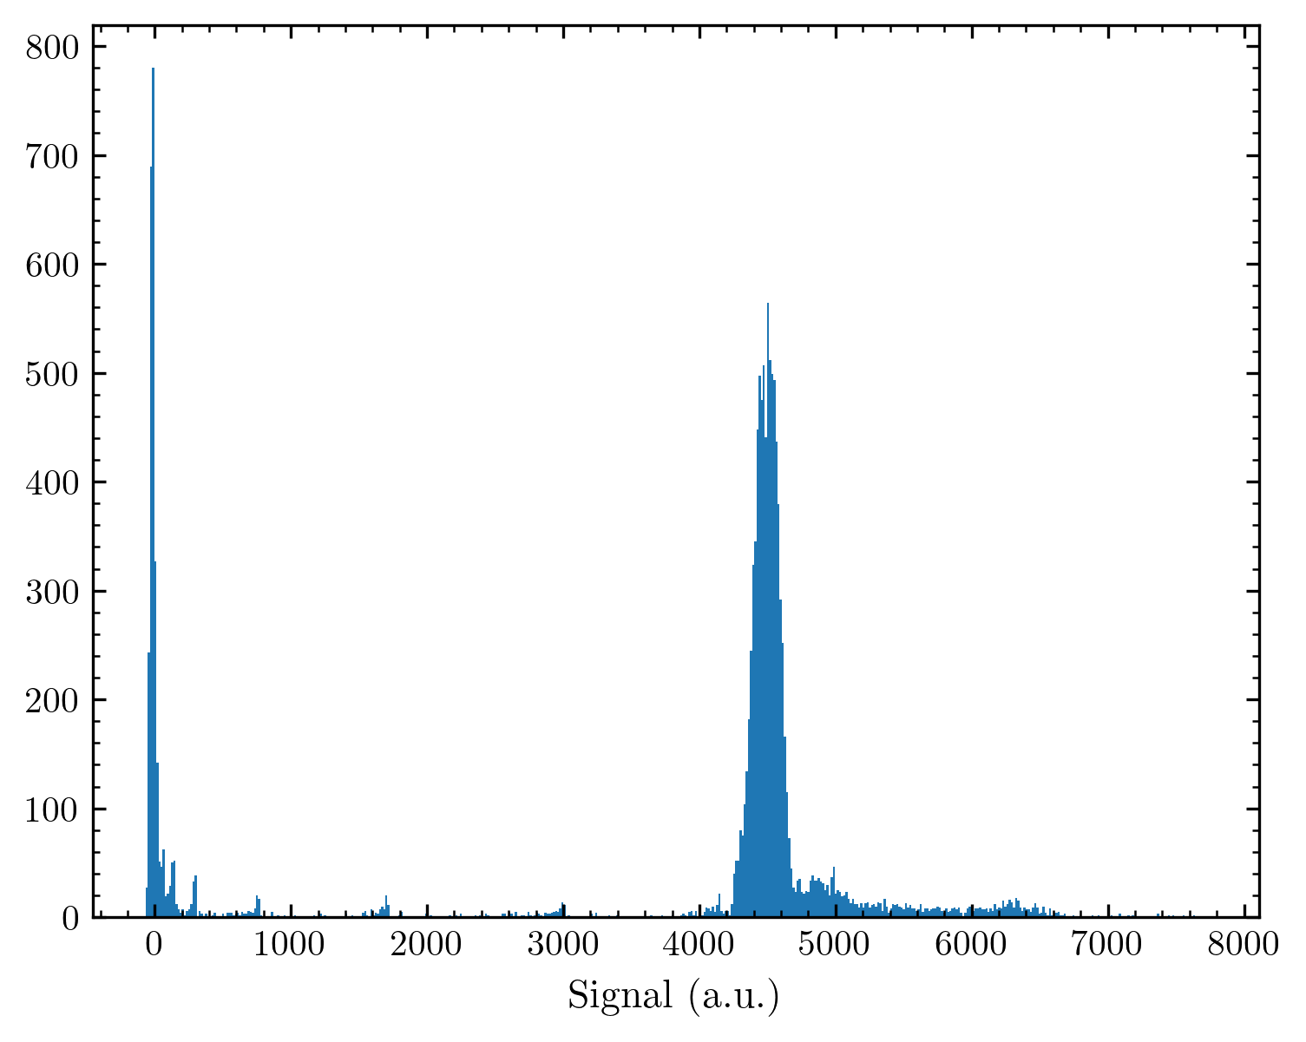
Influence of intensity_limits
The min, max of signal space used to assign colours in between is called intensity_limits in my code (and can be handed to the plot function Analyzer.plot_map)
One example below:

Slide 22


What about the levels?
10 Levels
1200 dpi | .png
427 kB
100 Levels
1200 dpi | .png
732 kB
256 Levels
1200 dpi | .png
944 kB
Max available: 256 color levels from color maps – but I do not see any improvement between 100 and 256 levels (so far, I used 100 levels as a compromise to file size) – I will probably change to 256 since its not that much bigger

Slide 23
Matplotlibs Pcolormesh
Takes X, Y arrays that give the corners of rectangles that are assigned a signal value
I have to generate the edges from the X, Y arrays in my code, since these arrays give the middle coordinate of each pixel
I subtract half the step size to the next pixel to achieve this for every pixel
Same signal color assignment as before
Advantage: Rectangles can have different sizes, and thus, the spacings in between diodes (with no signal information) can be illustrated.

Slide 24

How Pcolormesh looks
Because of oversampling the diode spacing is negligible here!

Slide 25
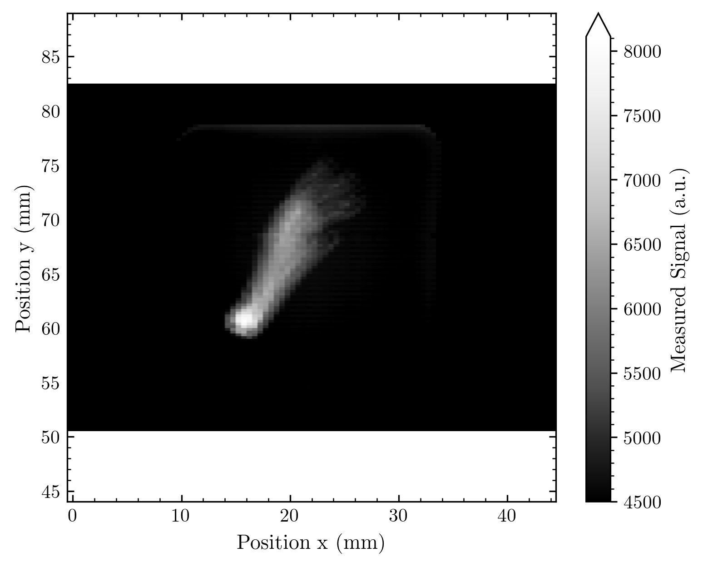
Different example (diode spacing visible)
This function resembles the real image information obtained in measurement! (The missing information for the diode spacing is interpolated between the two neighbor cells)

Slide 26
Matplotlibs Imshow
The standard for image illustration in Matplotlib / Python, but:
Takes 2D signal array, which values are assigned to a colourmap (as before)
The entries of this array are seen as equally sized pixels (The corners of the image are specified with the extent parameter, and thus the image is assigned to coordinate positions)
Gives nice functionality (e.g. the image is automatically scaled to a scale-true size; interpolation options are available; etc.)
But the data from measurements needs to be converted into equally sized pixels (which is what I did with some extra code)

Slide 27

How imshow looks

Slide 28
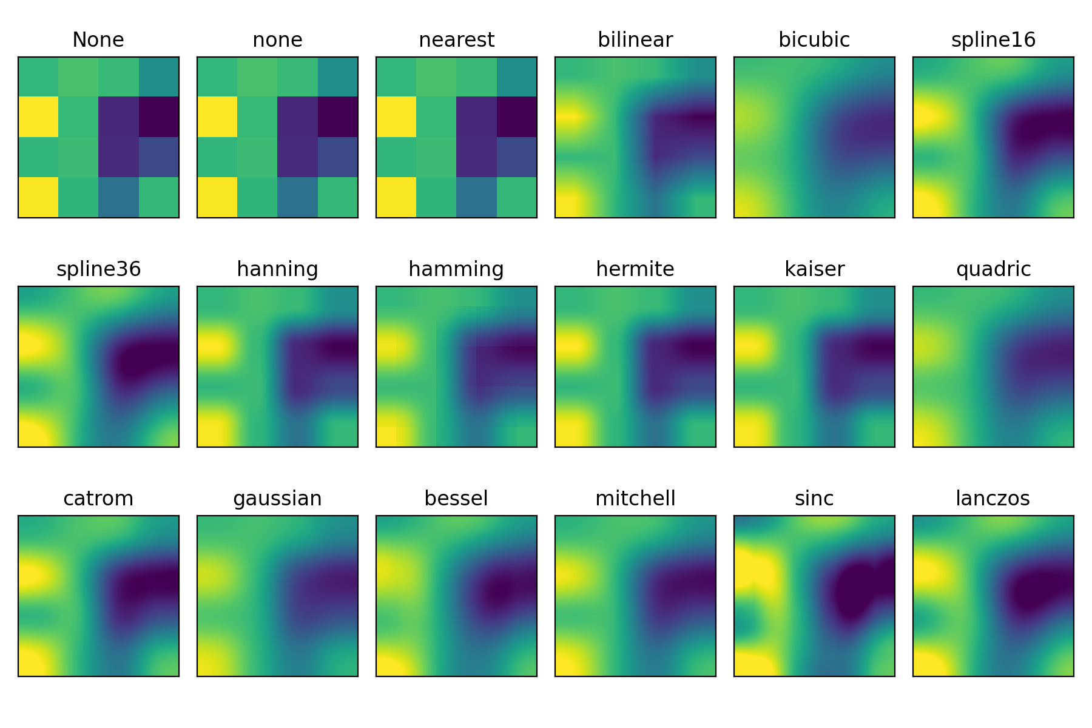
Imshow interpolation?
I tested all for several examples from our measurements!
But: Too long to put all into this presentation (also not possible on one slide) – so I focus on some important)
From Matpltlib documentation: https://matplotlib.org/stable/gallery/images_contours_and_fields/interpolation_methods.html#sphx-glr-gallery-images-contours-and-fields-interpolation-methods-py

Slide 29
Example mouse foot
Intensity scale adapted
X-Ray image style

Slide 30







Slide 31







Slide 32







Slide 33
Some interesting in direct comparison

Slide 34


Slide 35
Example misc shape
Just the most important
Seems like interpolation is not working here, I’ll try to figure out why

Slide 36
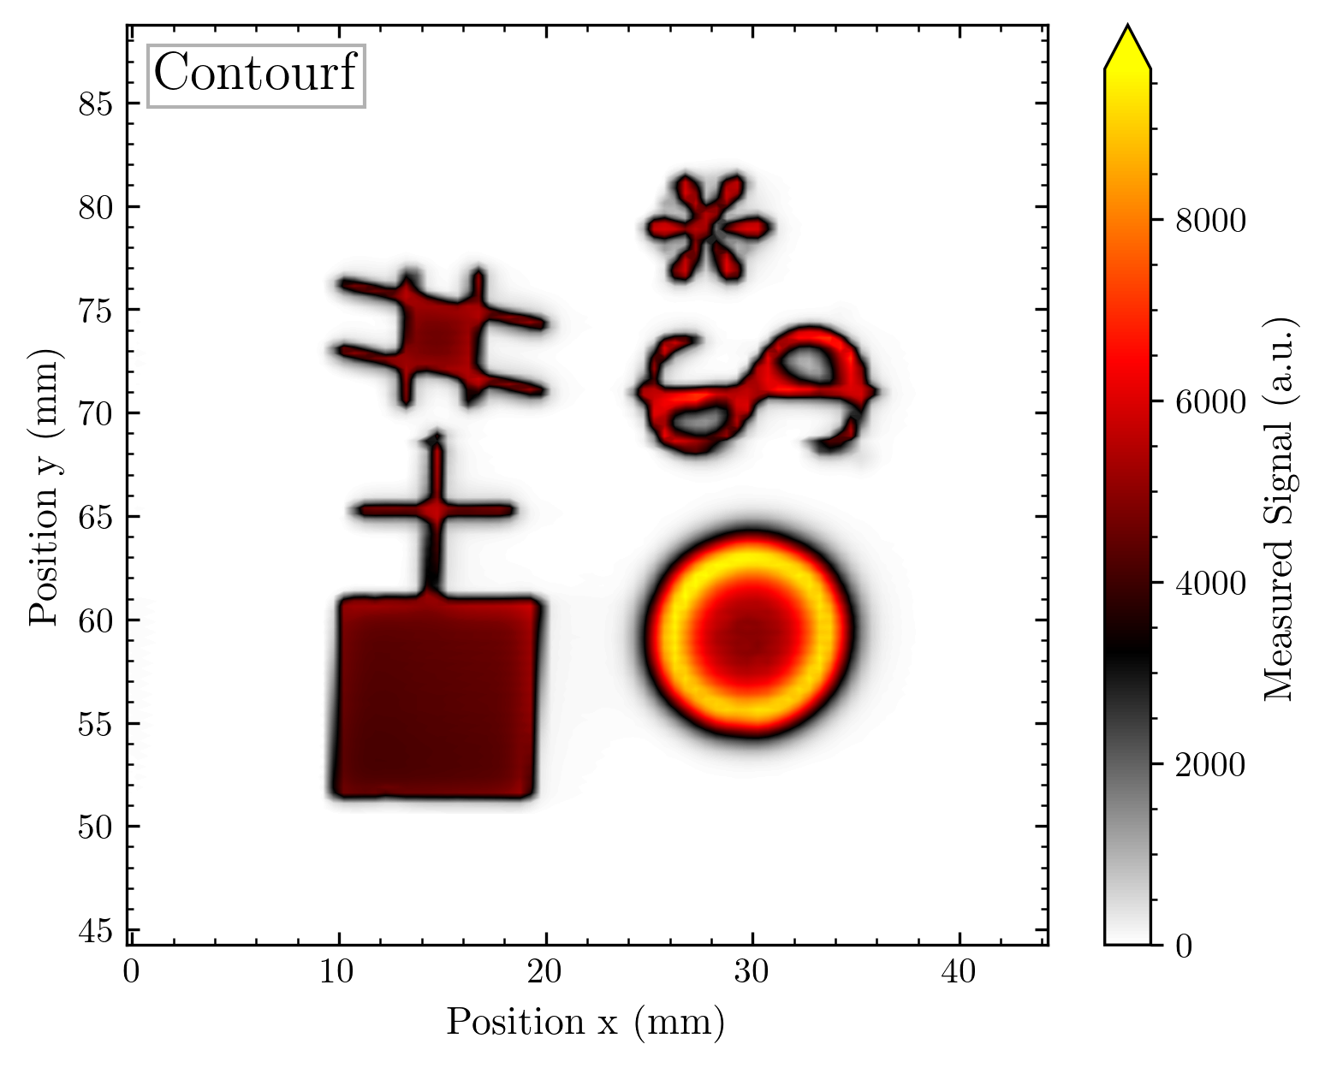
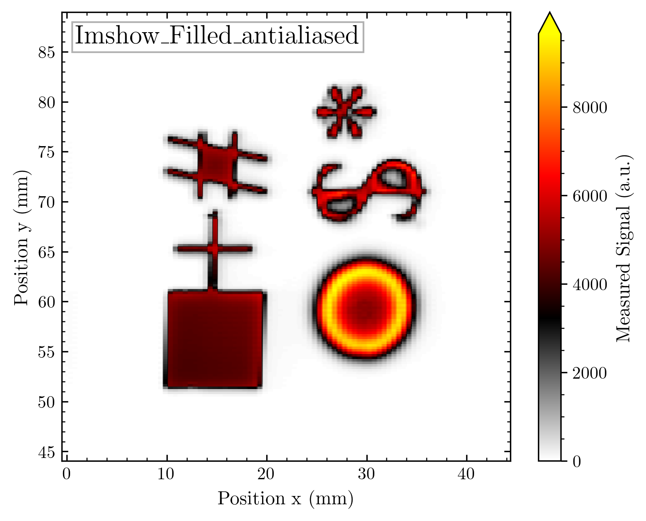





Slide 37
Seemingly no interpolation possible here, maybe too many high contrast edges? Some comparison with whitespaces:

Slide 38
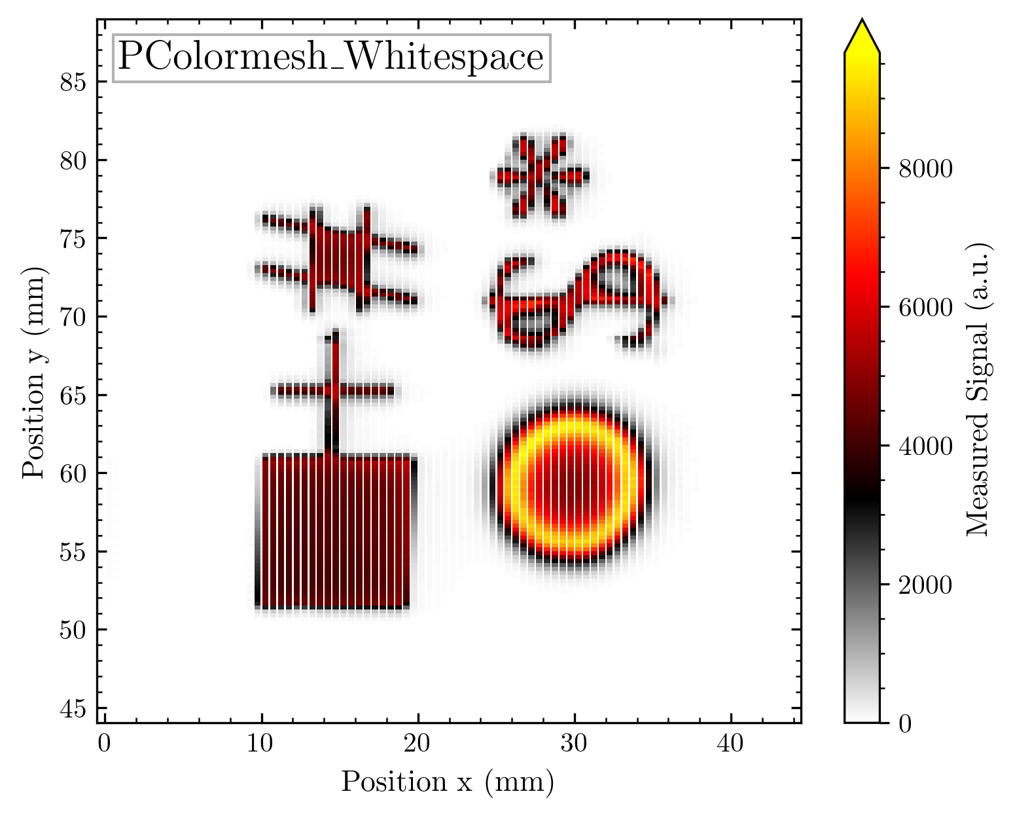
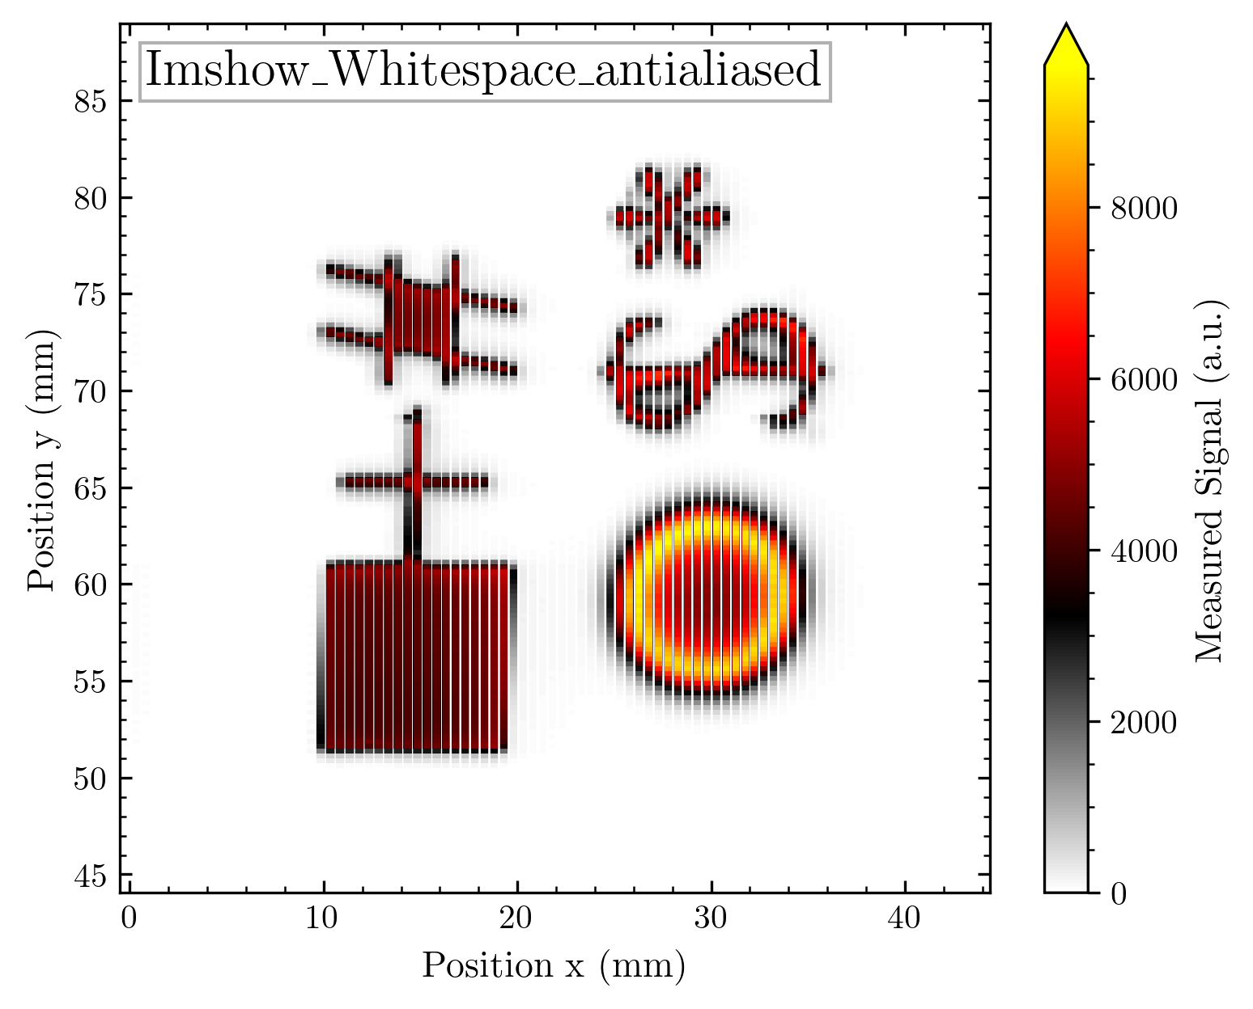




Slide 39
Either way, the whitespaces are not portrayed correctly. All images suffer from undersampling when saving them to .png

Slide 40


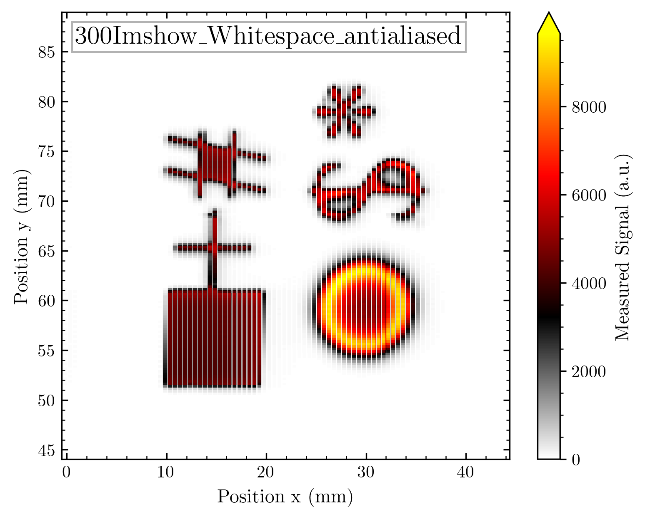
What about different resolutions?
414 kB
292 kB
122 kB
All are not portrayed correctly, and this is not just an optical problem! Some white spacings are saved with more pixels than others. I hoped that Imshow could solve this because all pixels are equally sized here. But the problem is still apparent.

Slide 41
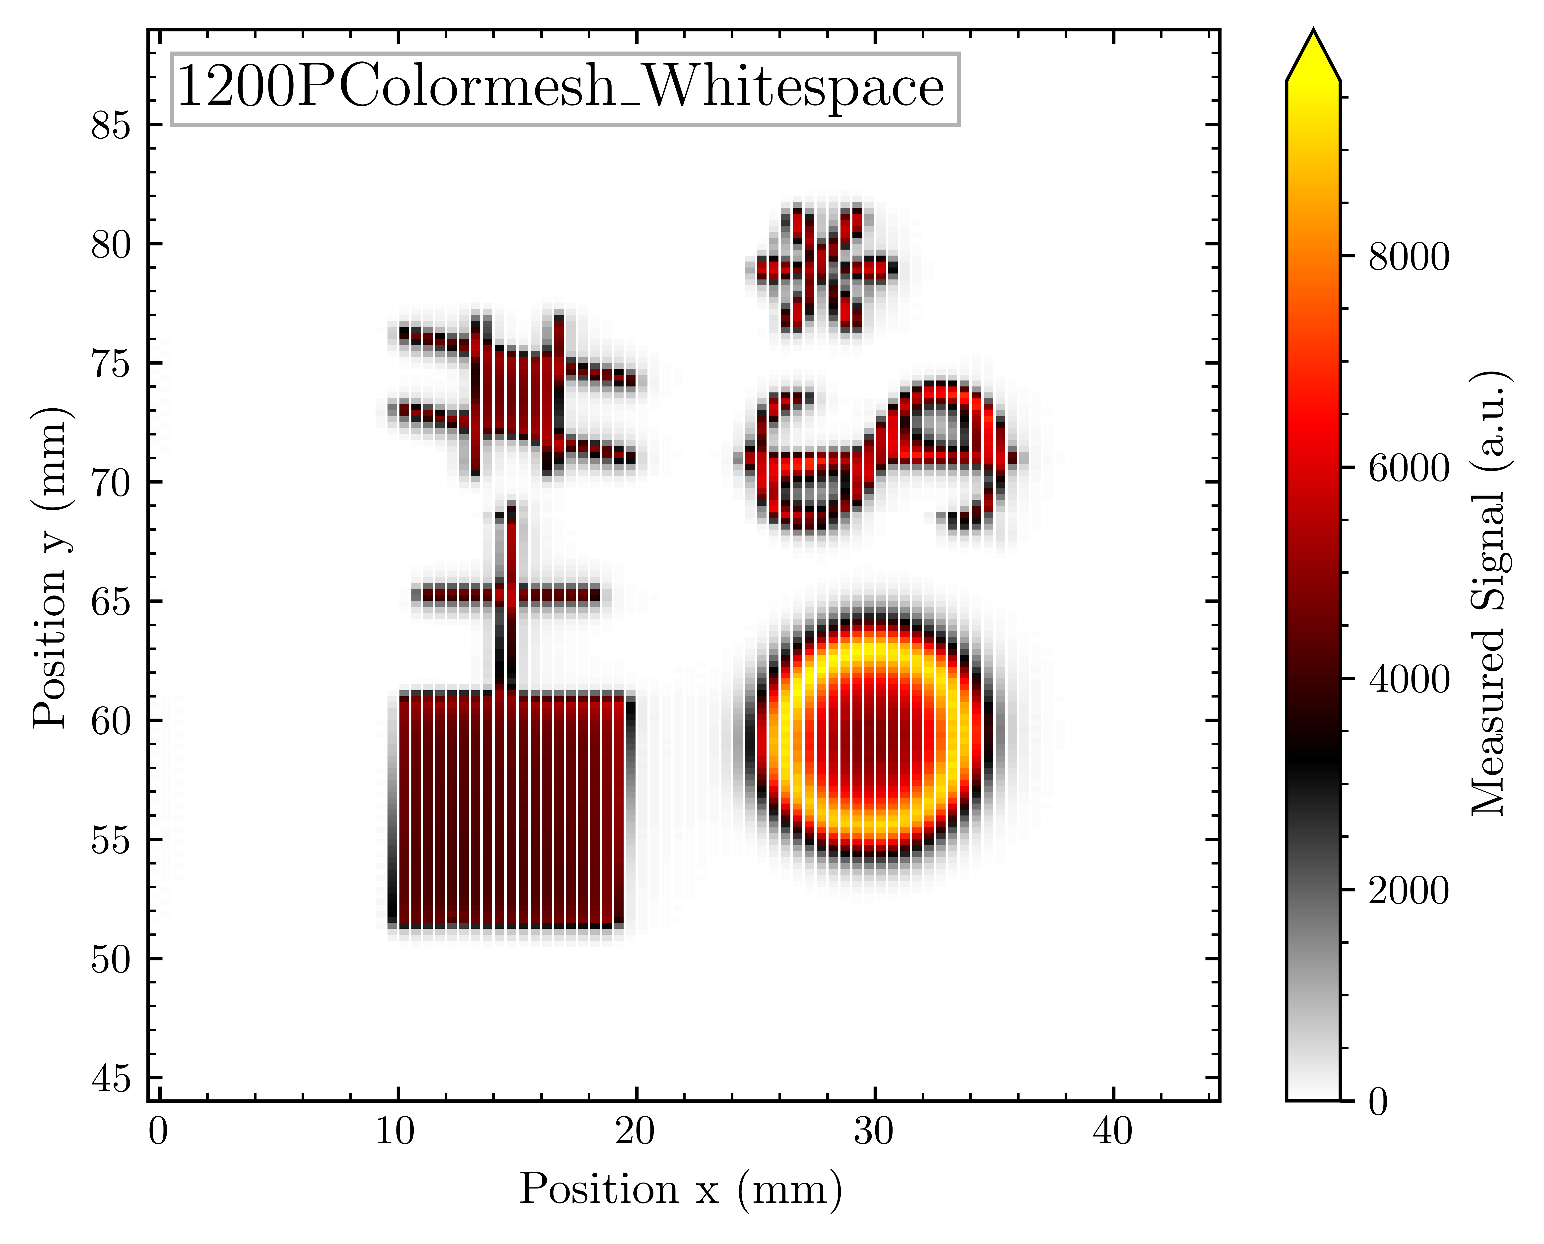


Pcolormesh?
412 kB
291 kB
91 kB
Better portrayed compared to Imshow! For 300 dpi the disparity in white spacing size is quite apparent, for the higher resolutions, it becomes less problematic.

Slide 42




Slide 43
Is there any visible difference among the resolutions for the interpolated images?

Slide 44







Slide 45
I do not really see any difference here – just the size varies from 31 kB up to 406 kB. I will stick with 300 dpi for these images for now

Slide 46
.png or .pdf?
Out of technical considerations easy answer from my side: .png
Why?
.pdf gets aliasing problems because it keeps contours/pixels as separate objects
.png supports lossless compression, .pdf not
.pdf gets far too large for the images (because of keeping e.g. contours as several objects)

Slide 47
What about the color map choice? There are plenty of options available – I prefer to have something perceptually uniform – but I have some comparisons following

Slide 48

Misc shape
There will be normal and _r = reversed versions of each map!
The benchmark is the self-design I used so far (I’d say pretty good for deciding signal variation from the background, etc.)

Slide 49
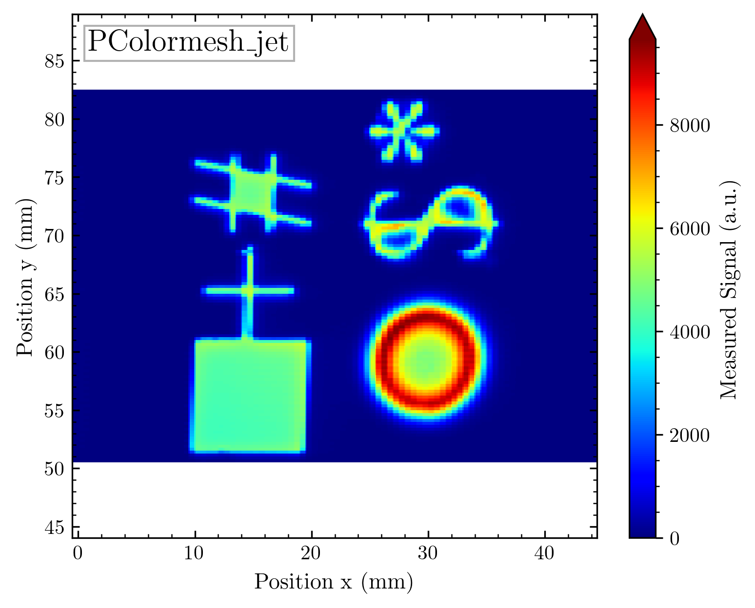
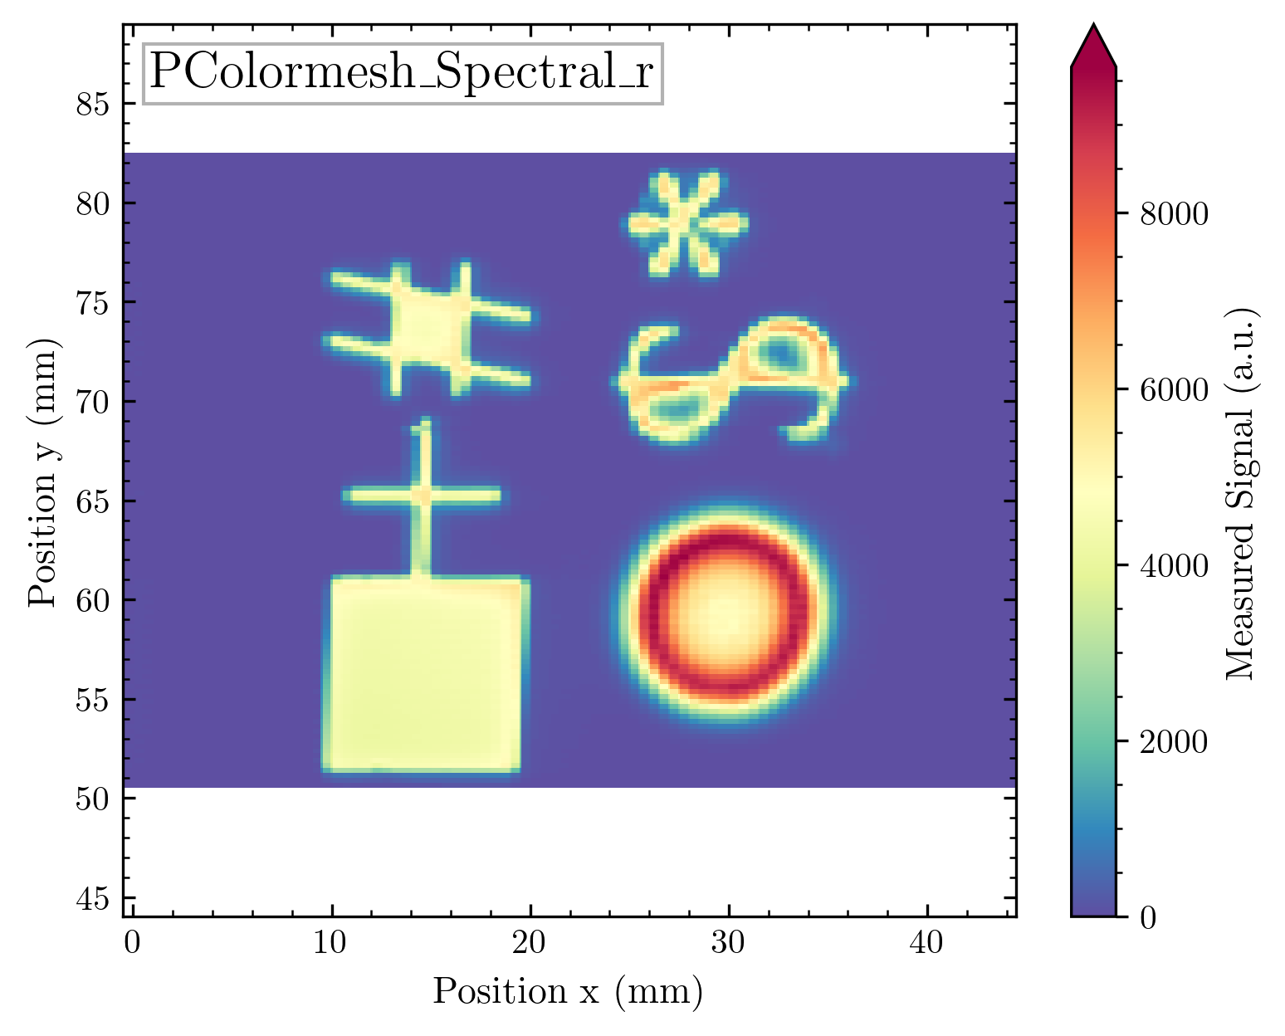
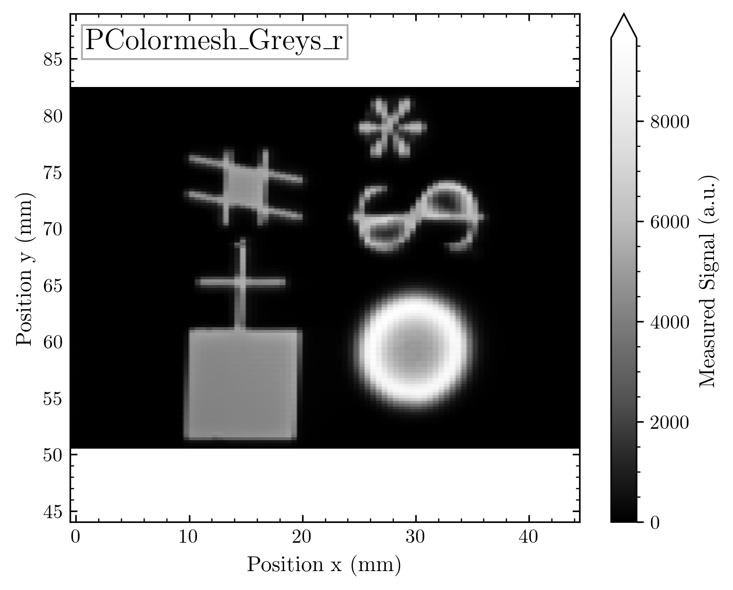
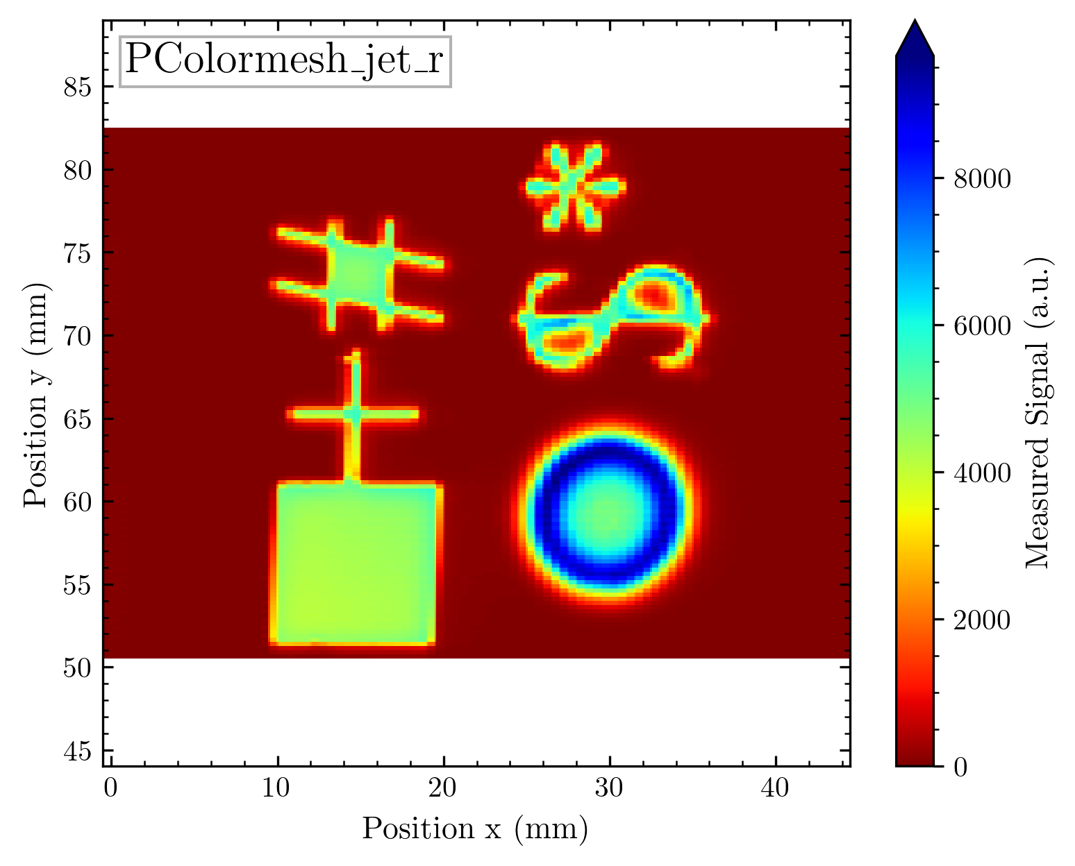
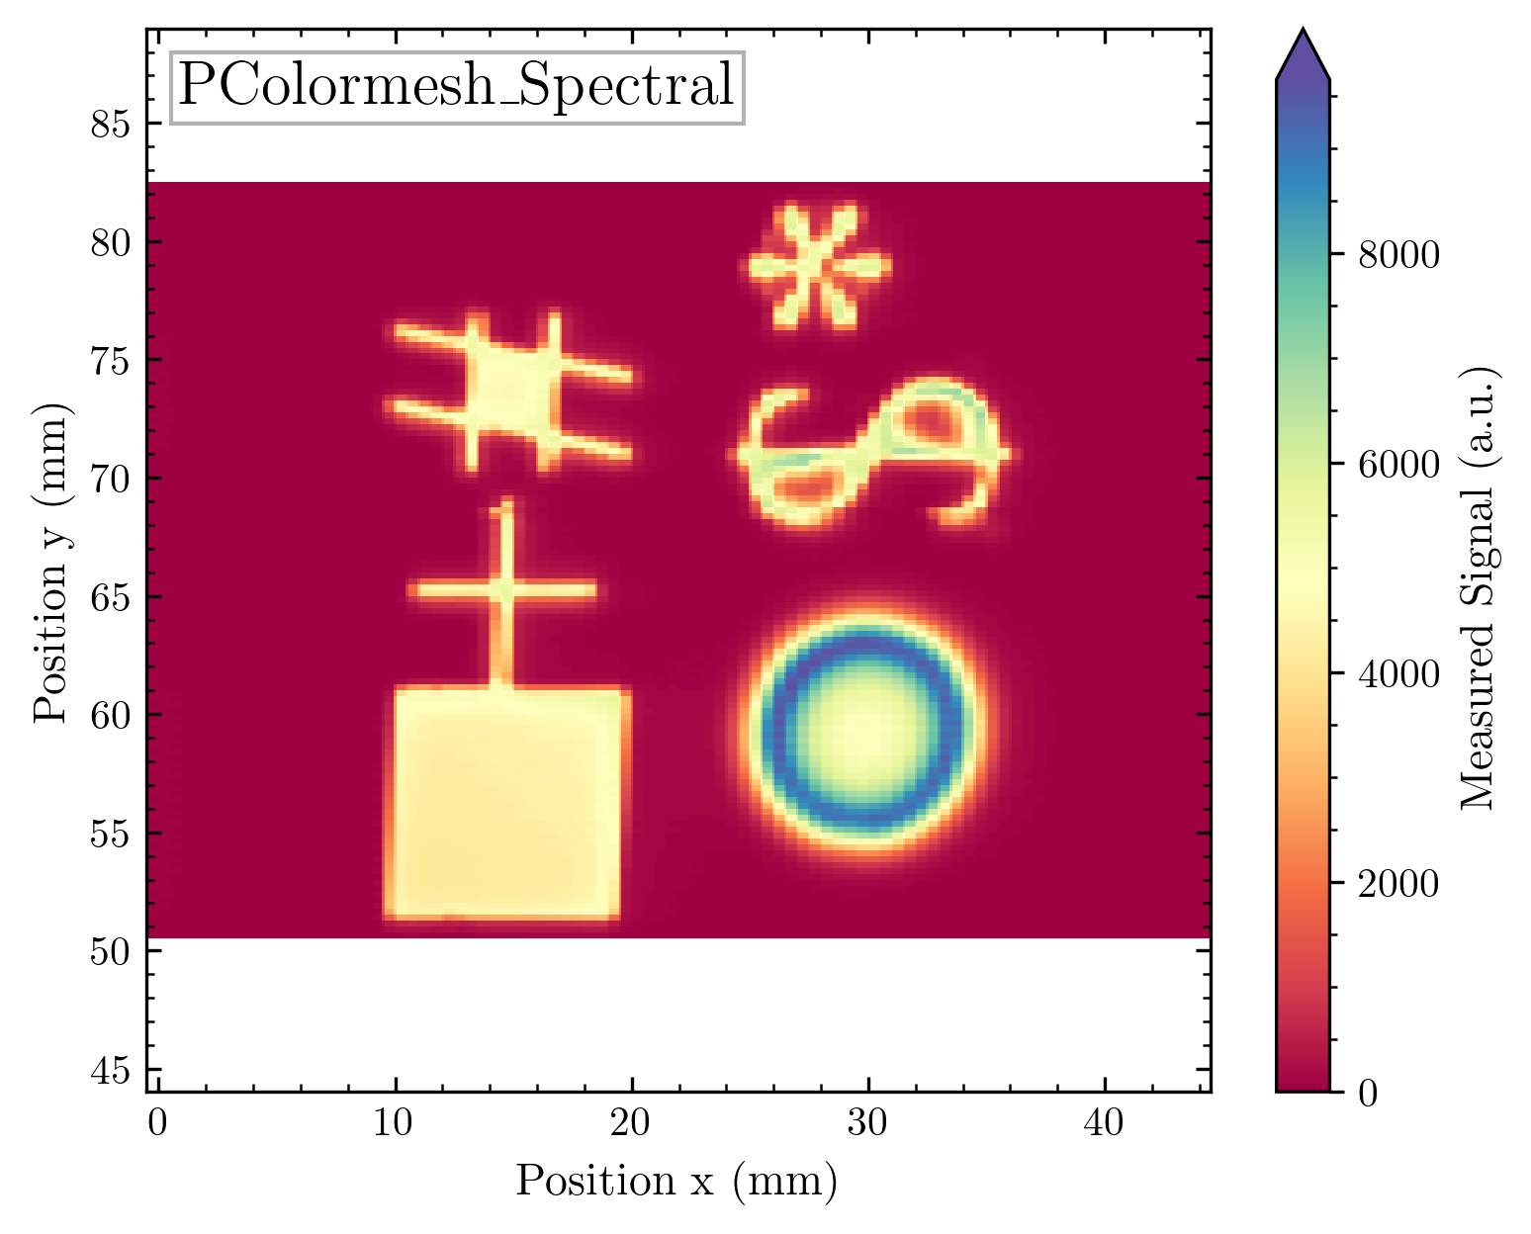
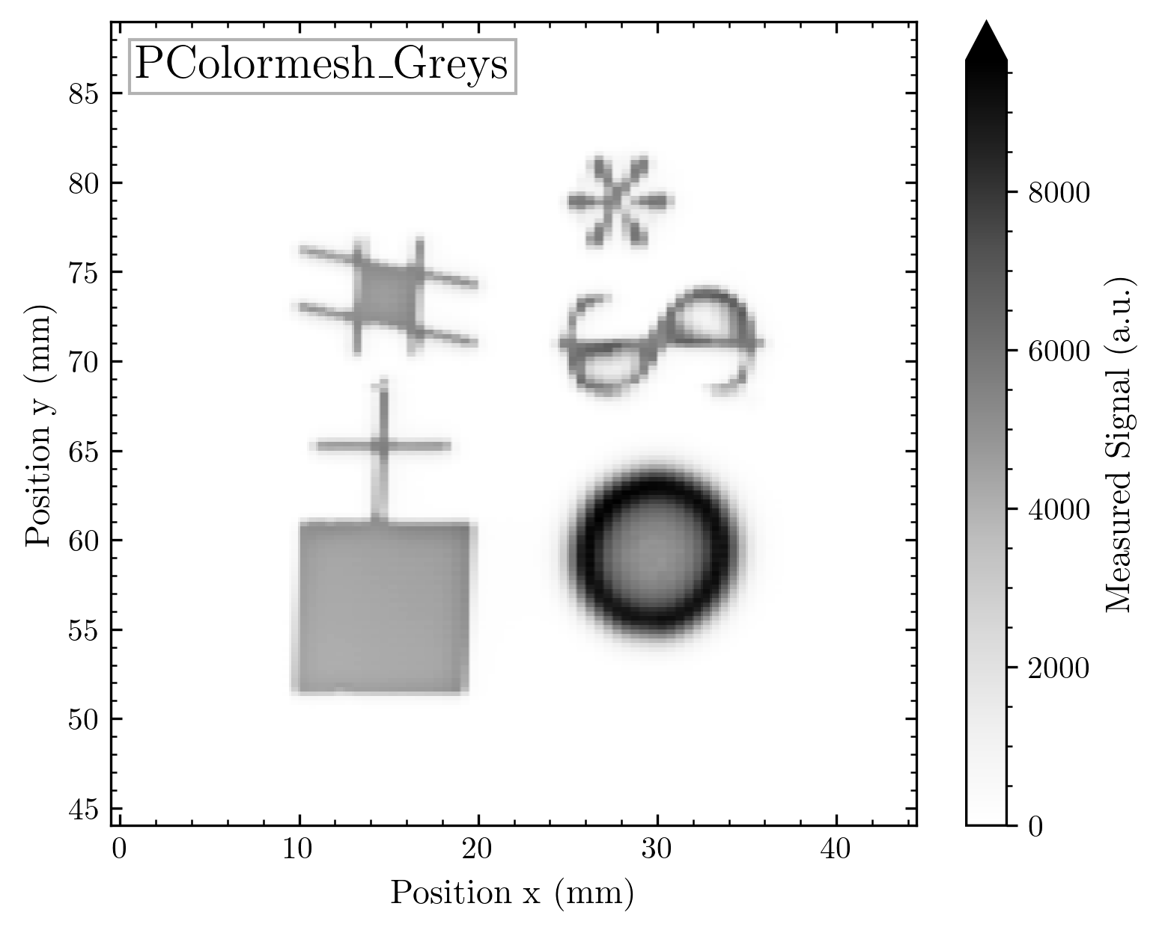

Slide 50
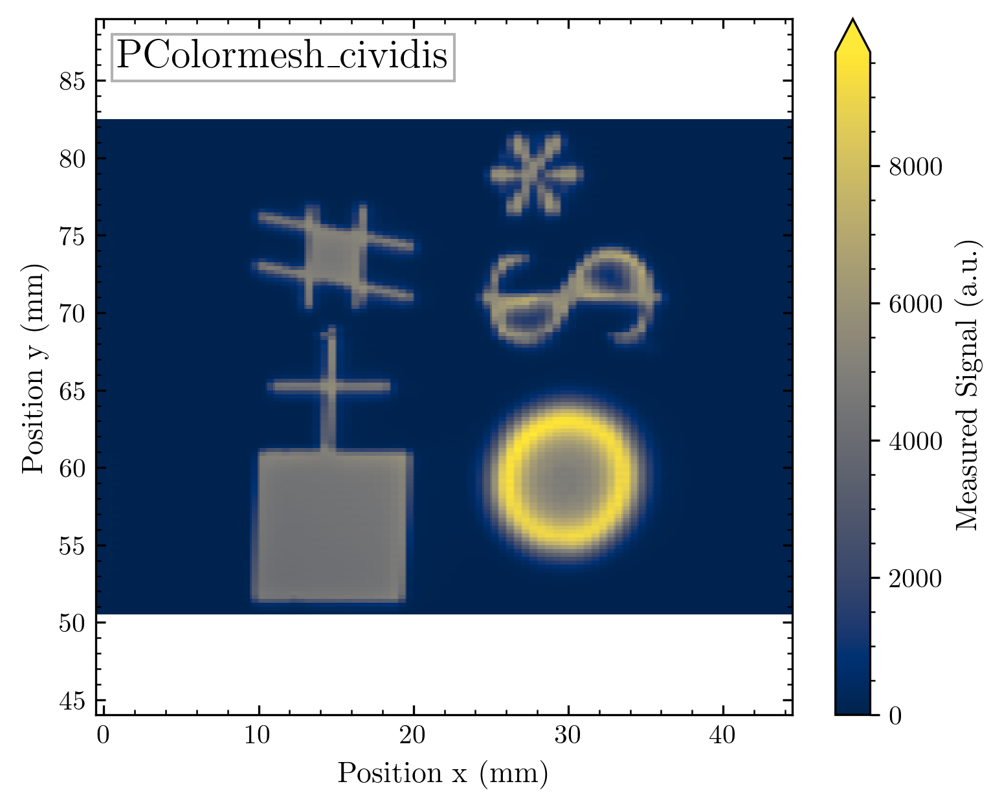
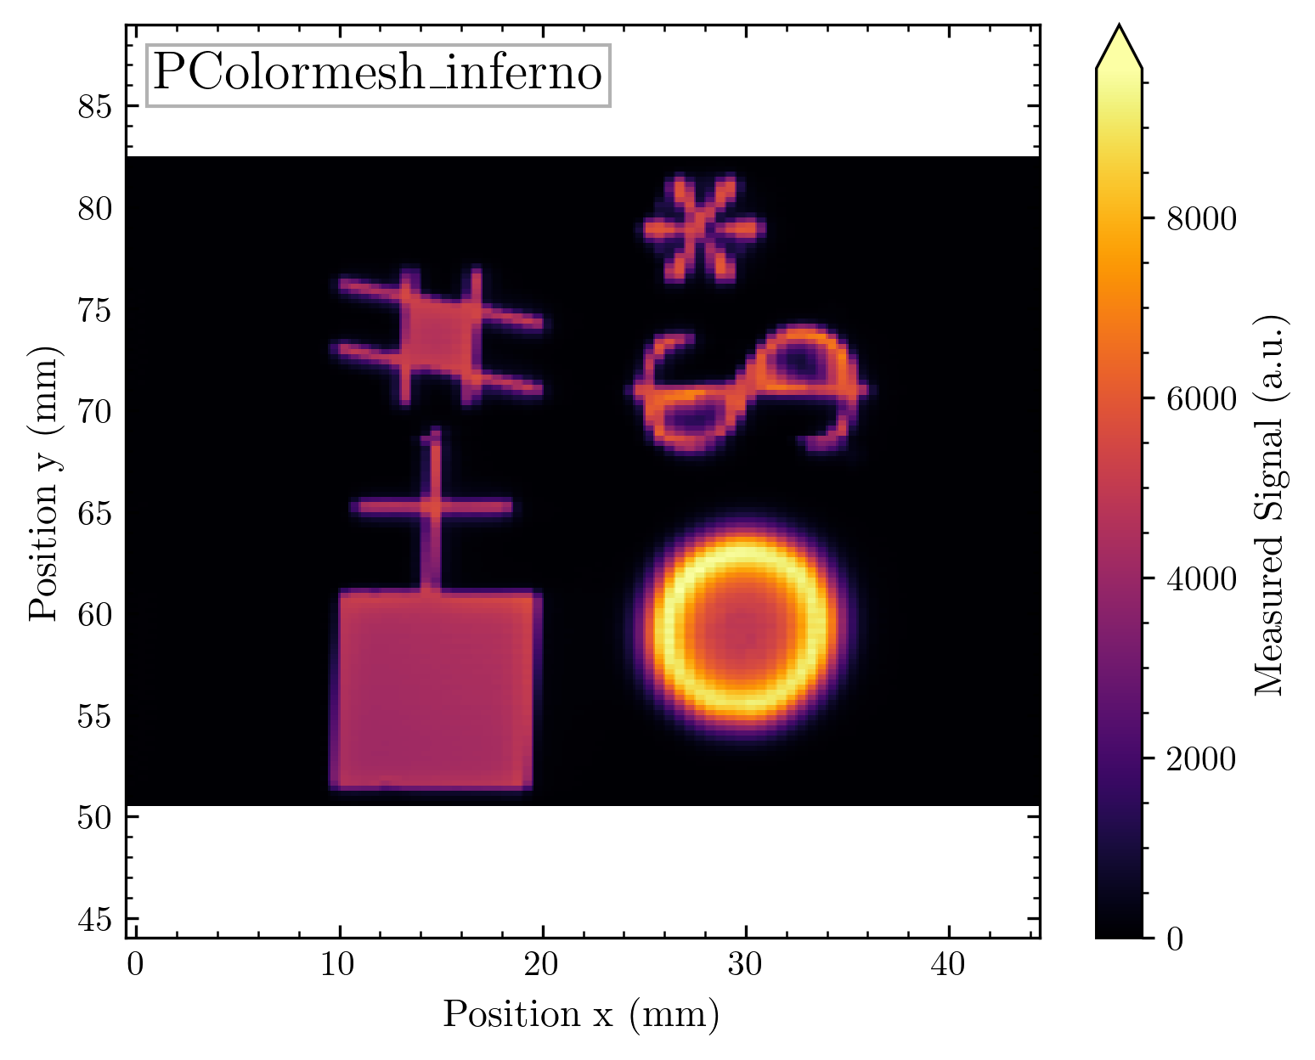
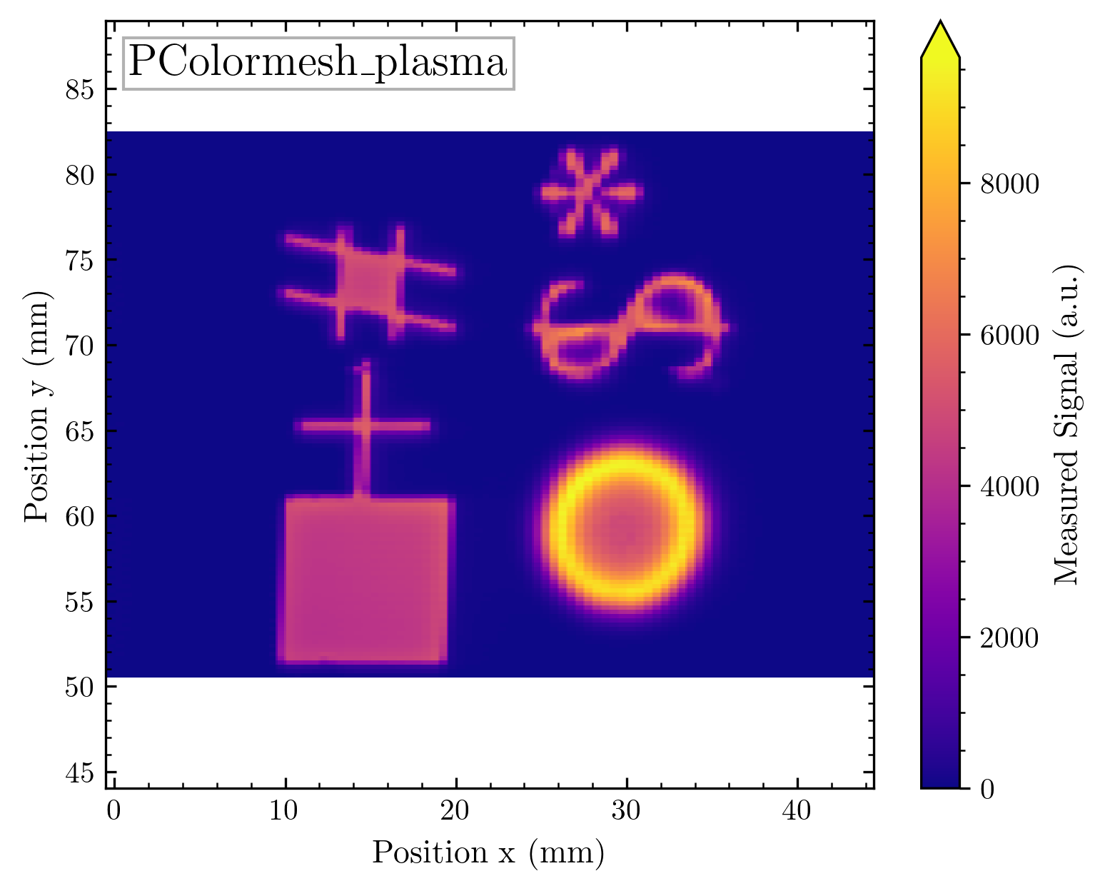
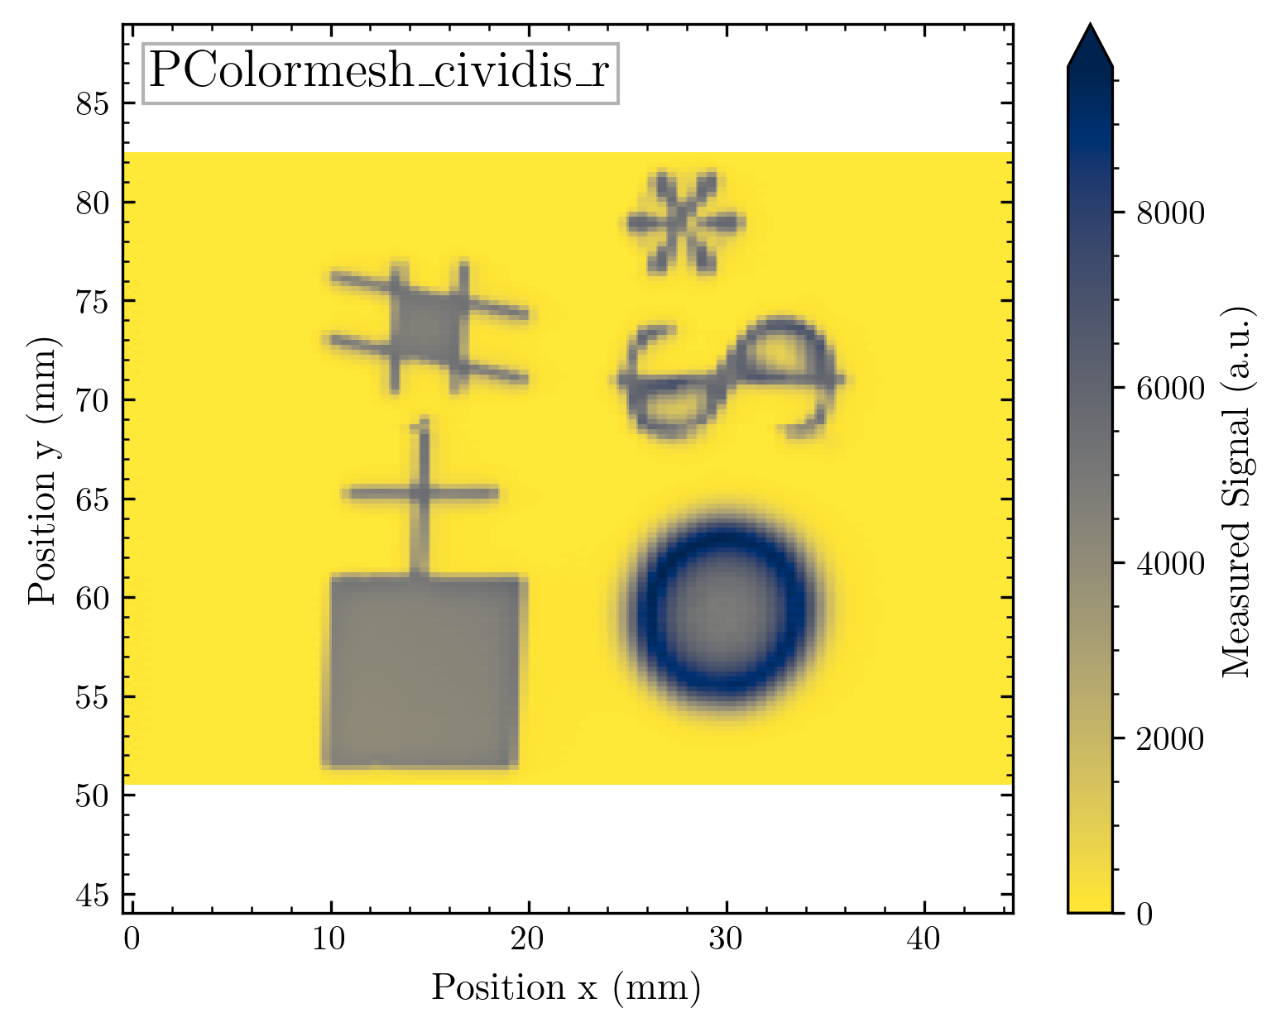
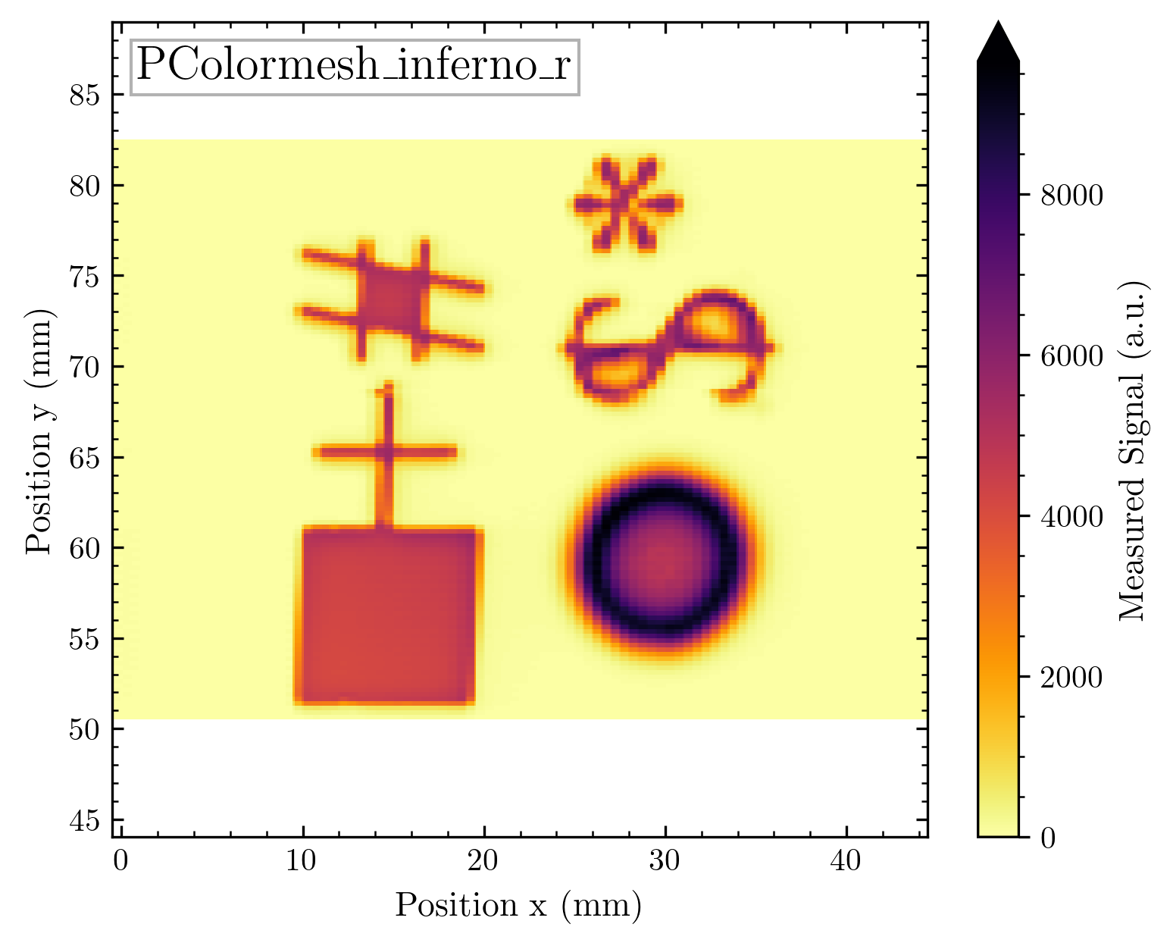
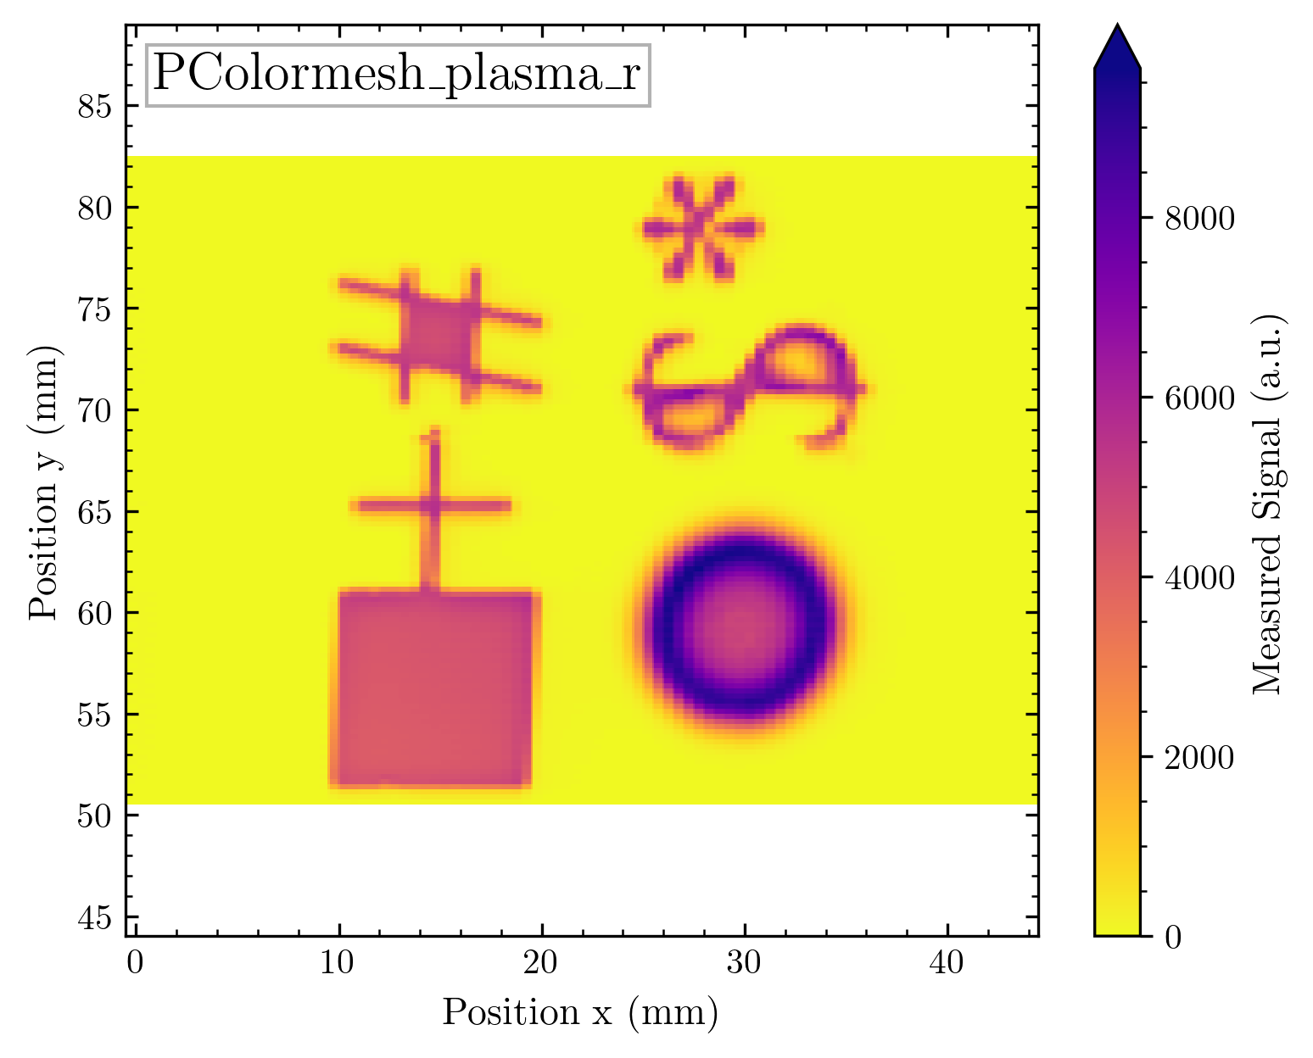

Slide 51
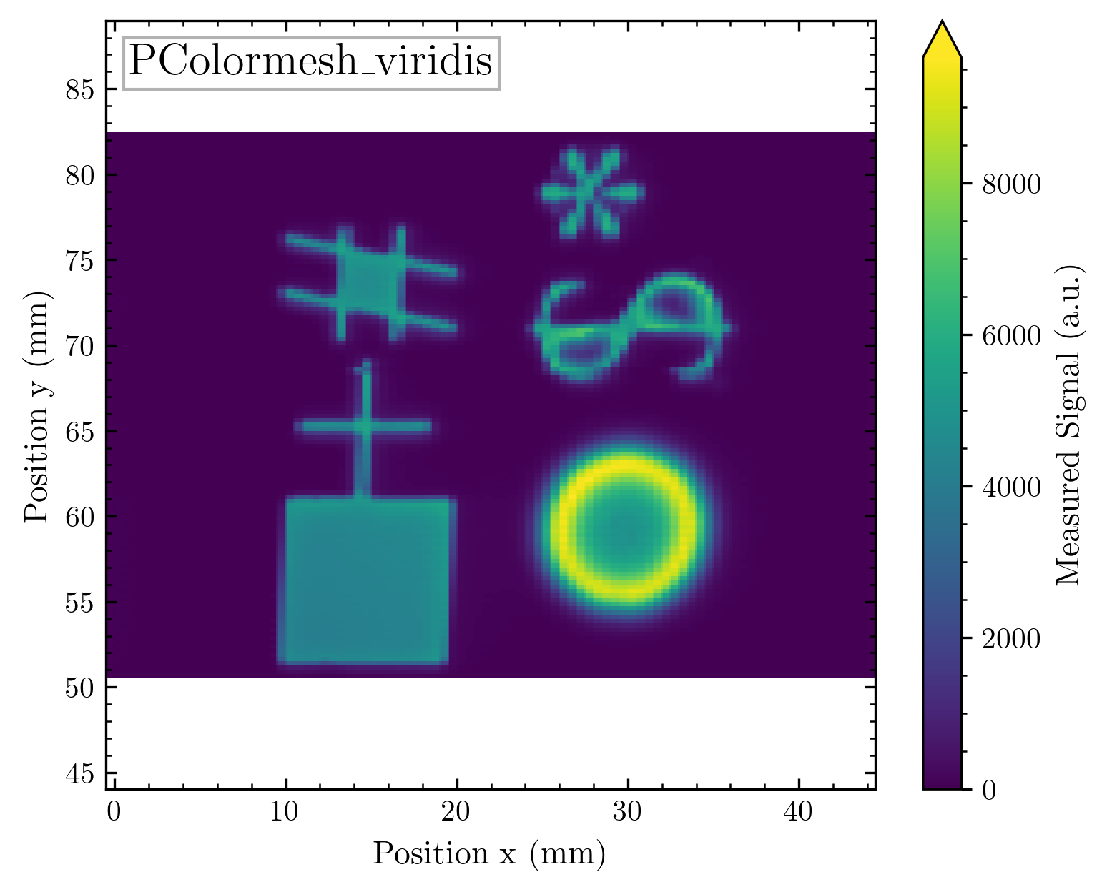
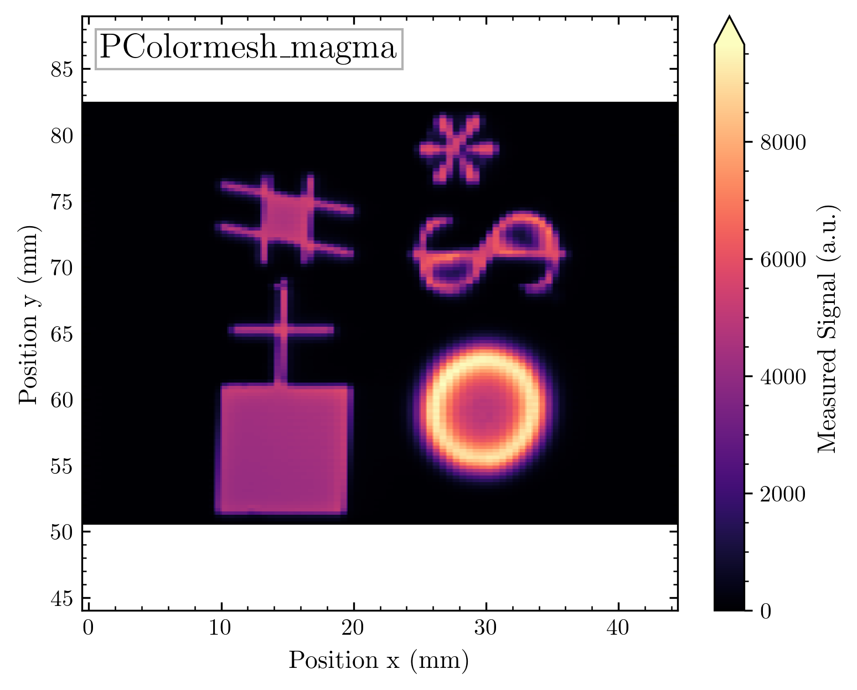
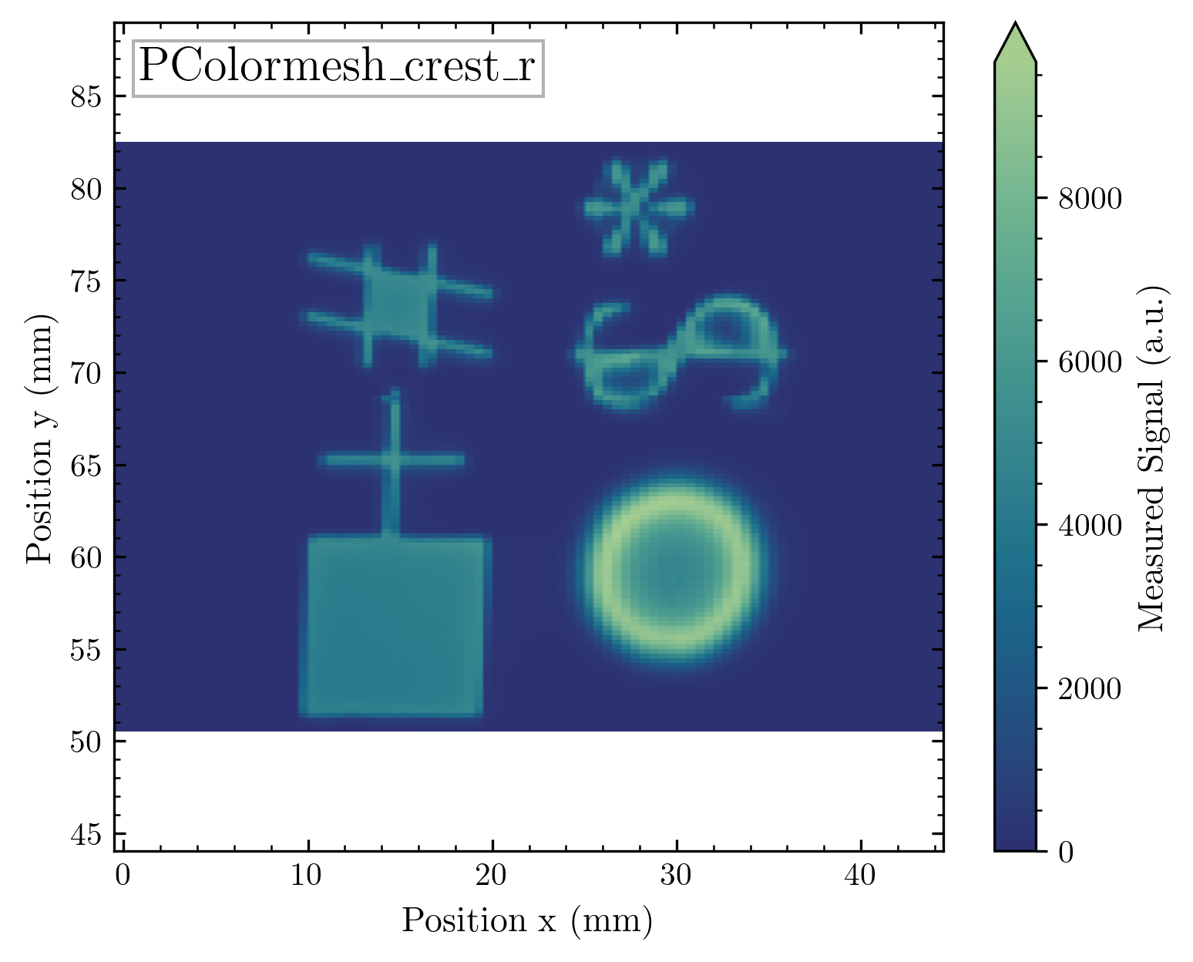
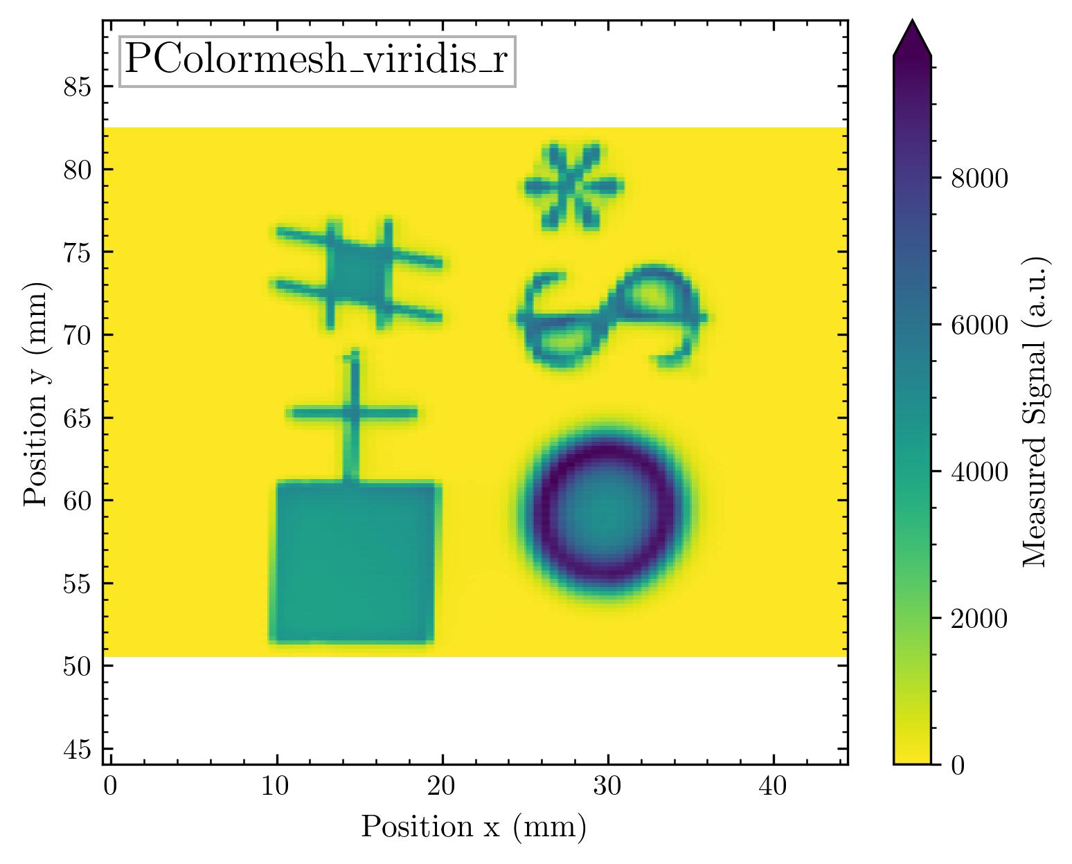
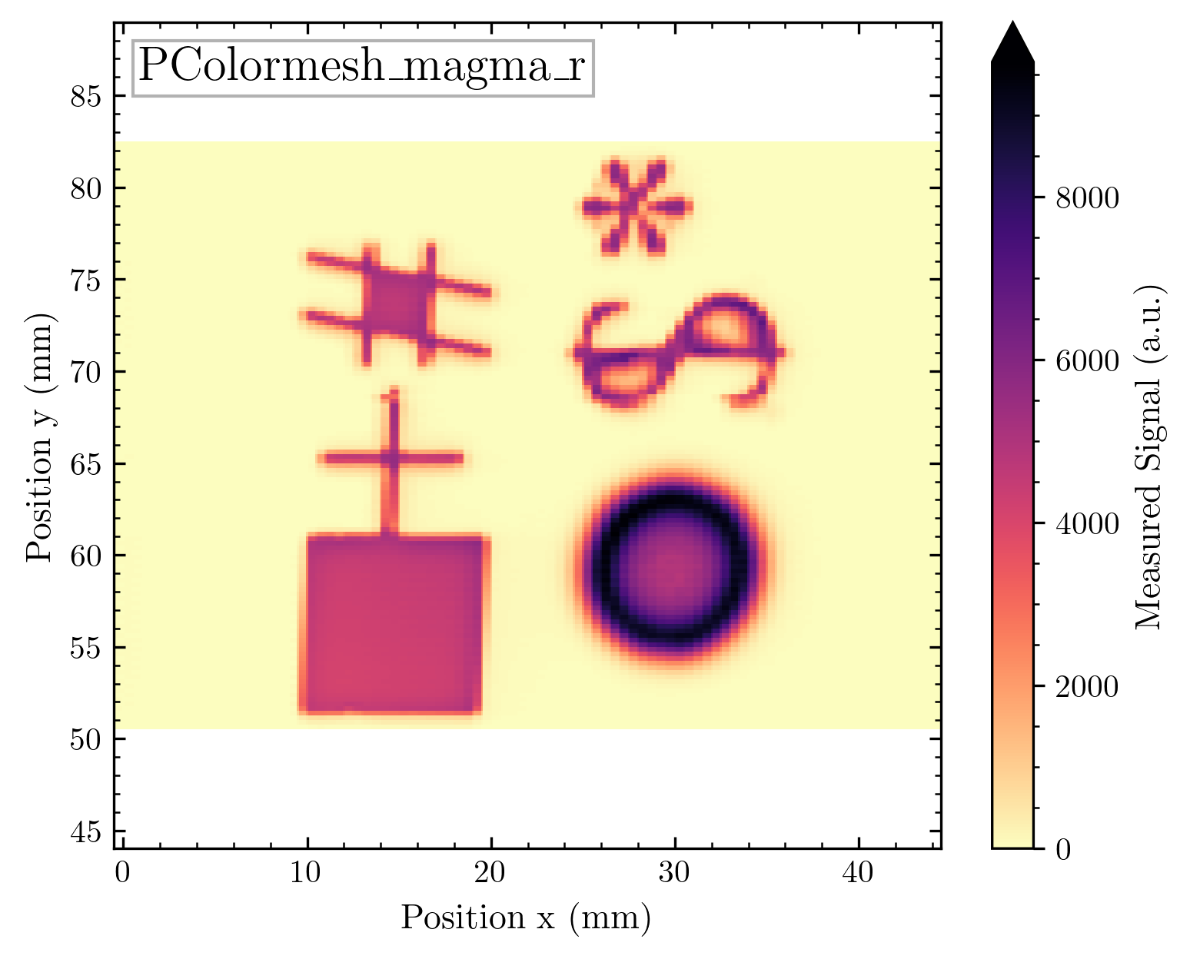
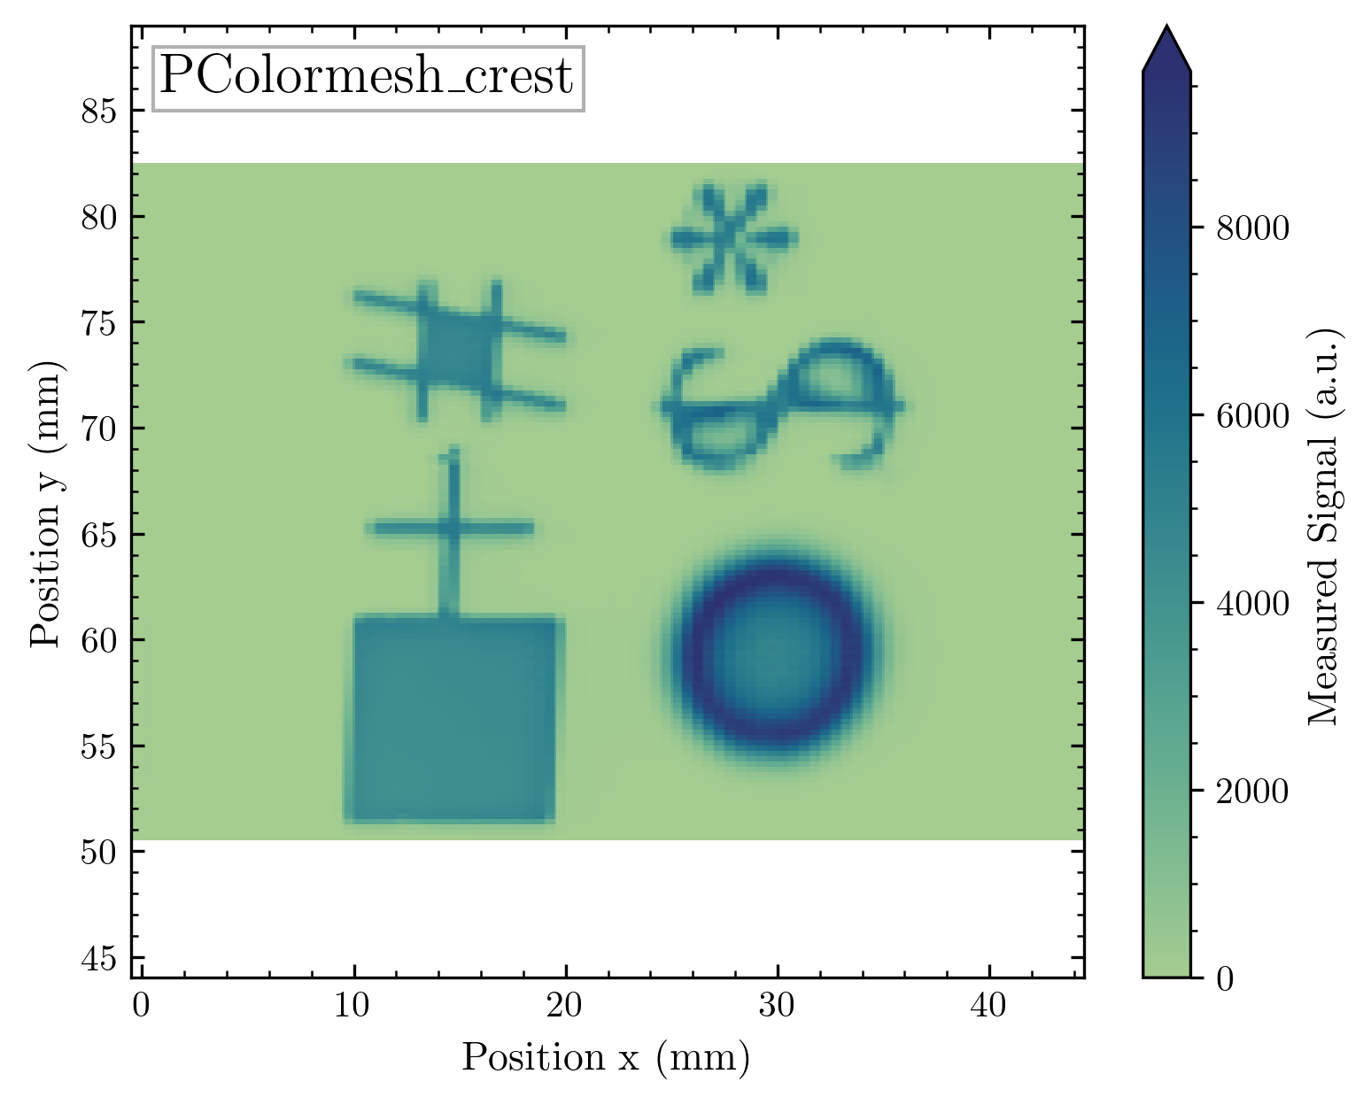

Slide 52
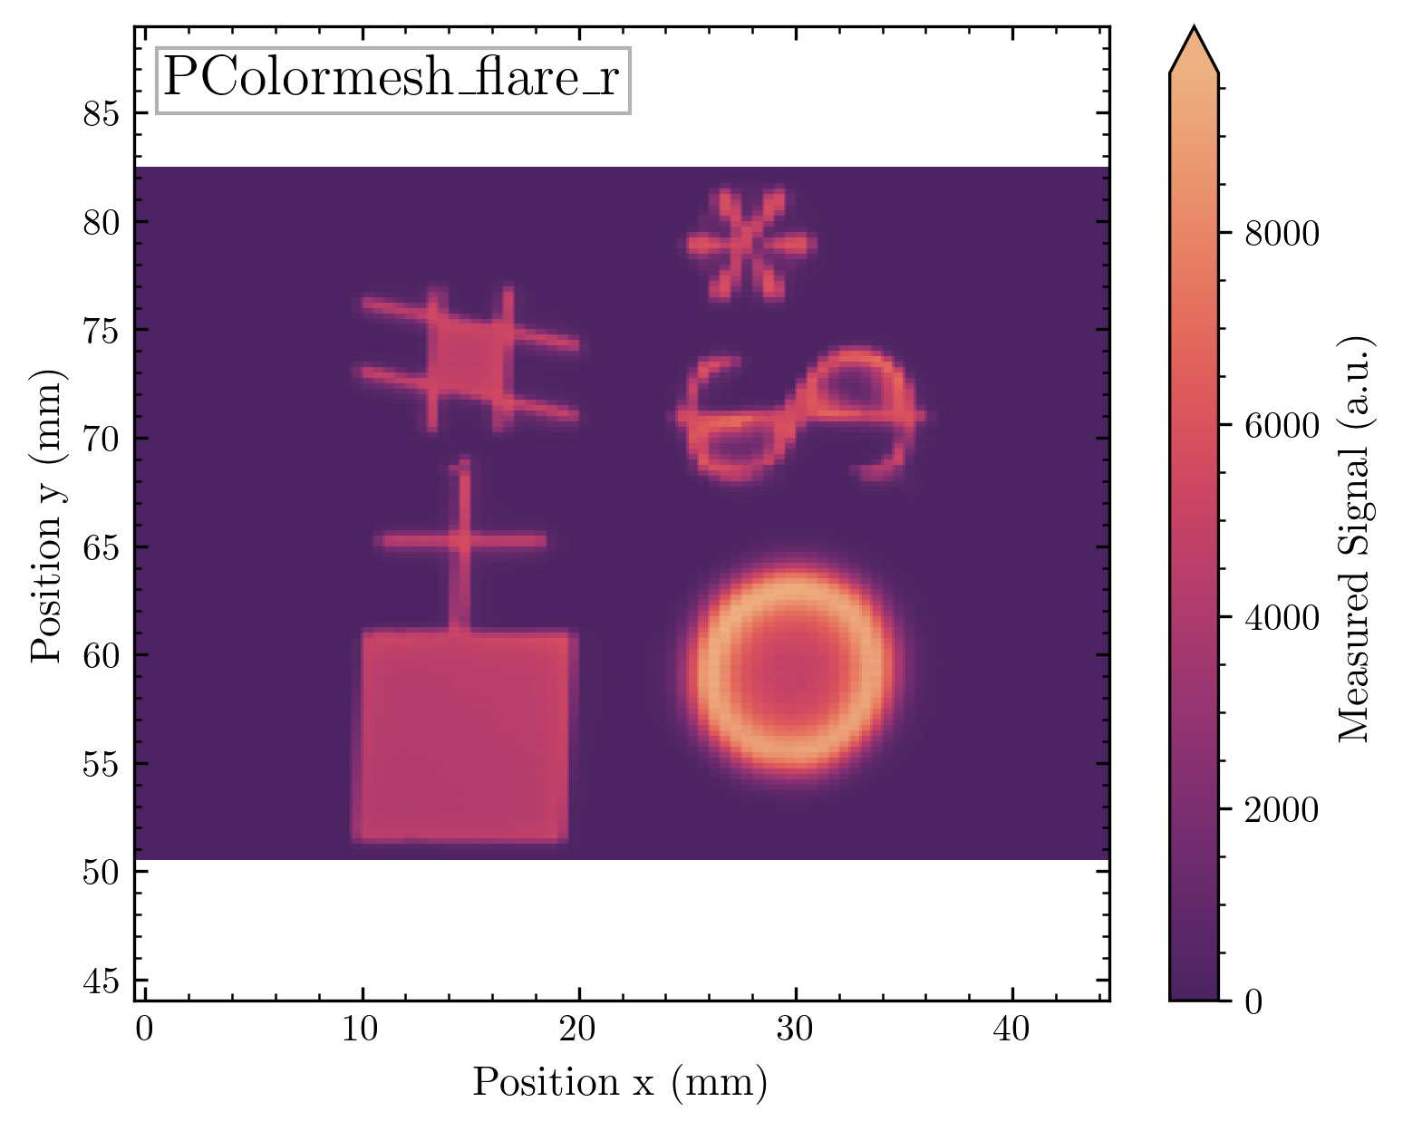
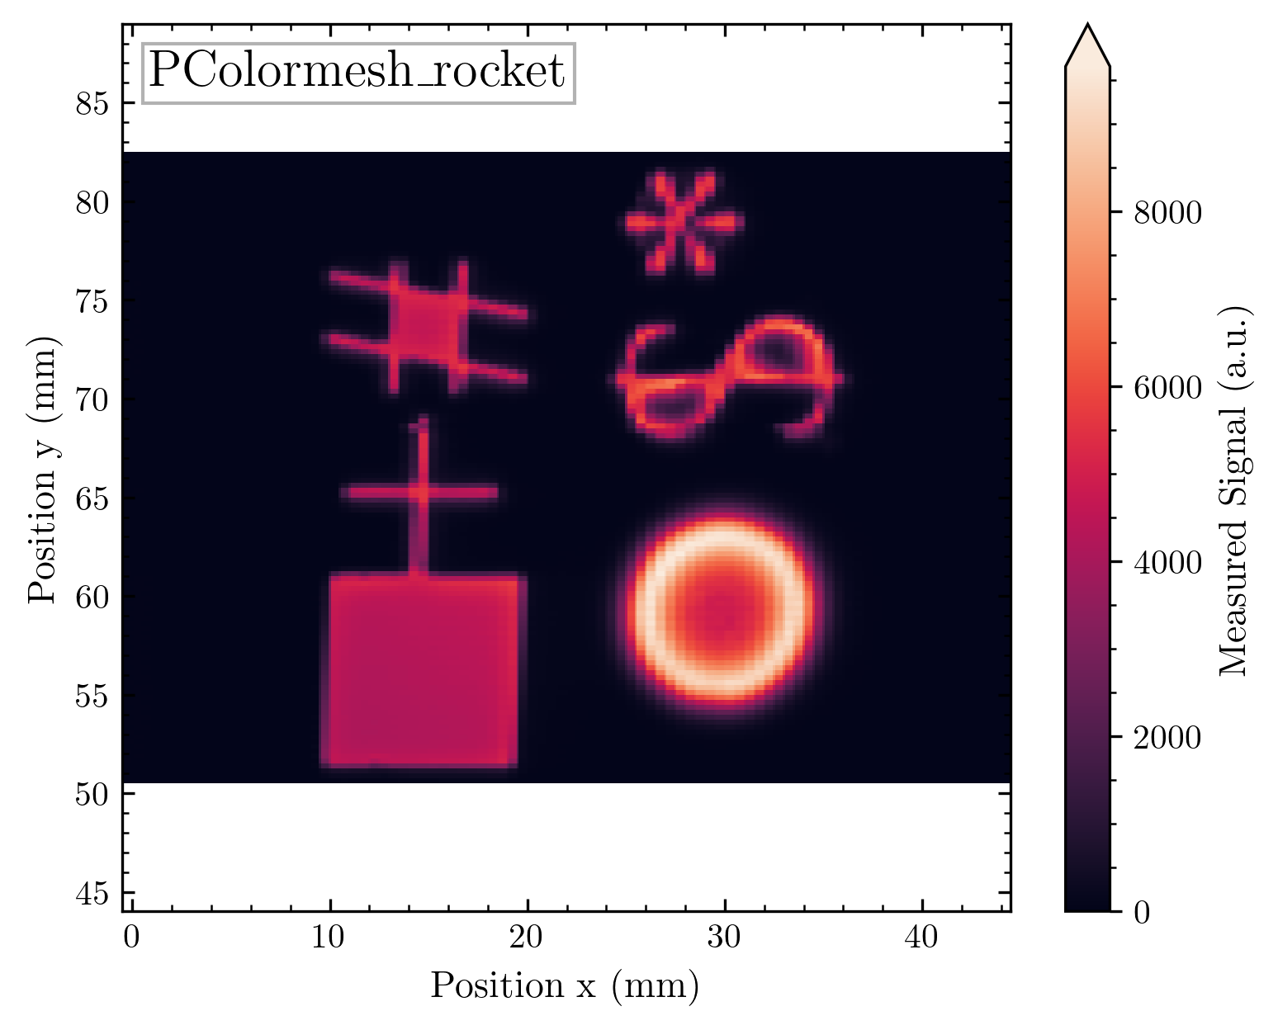
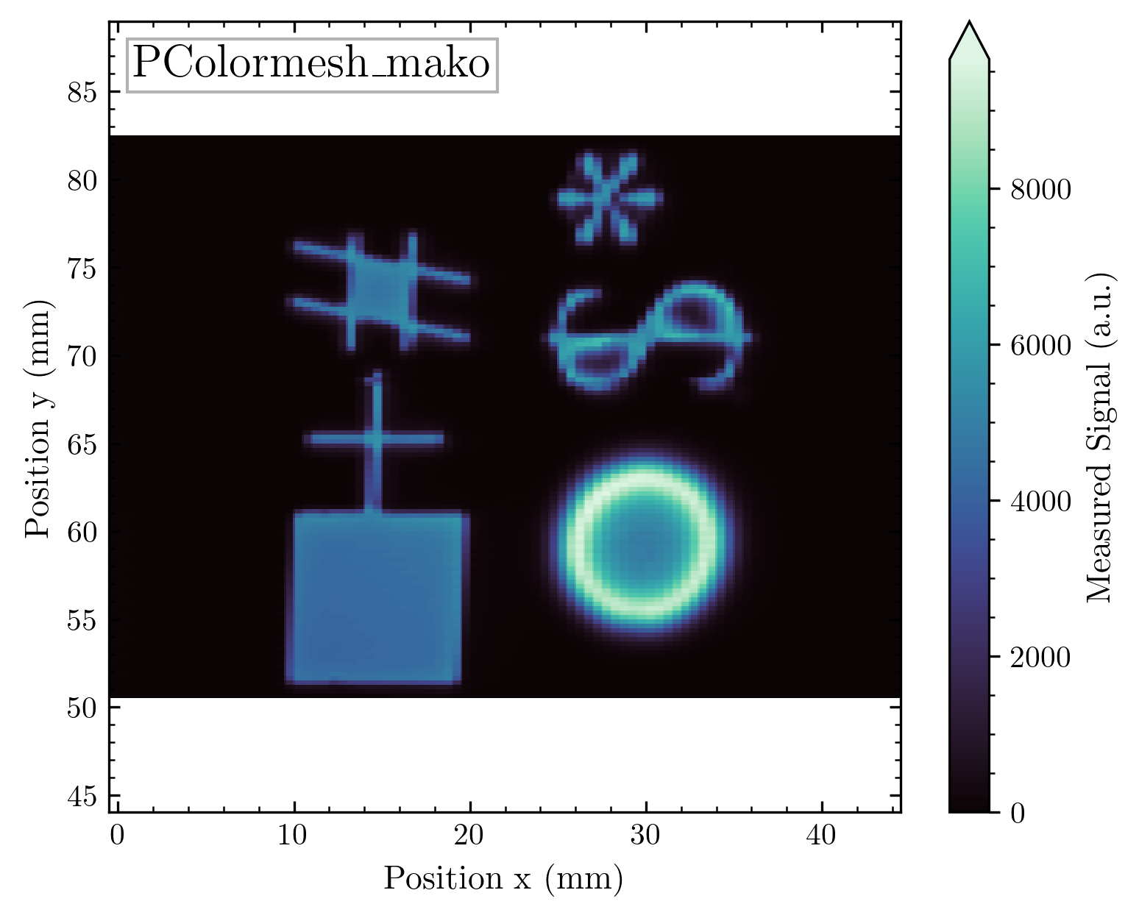
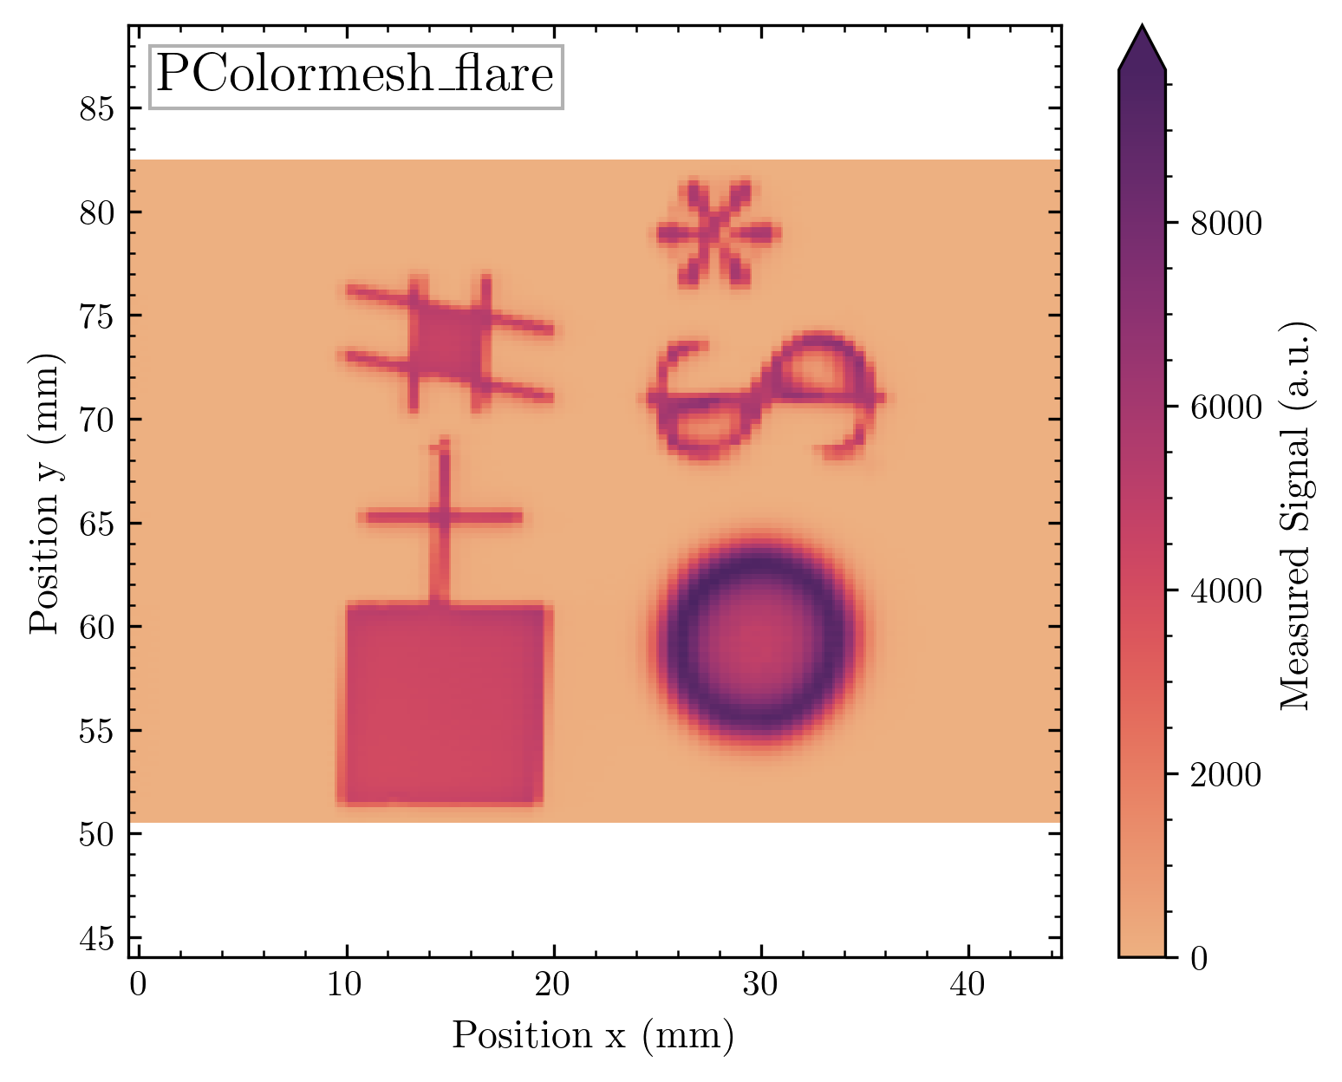
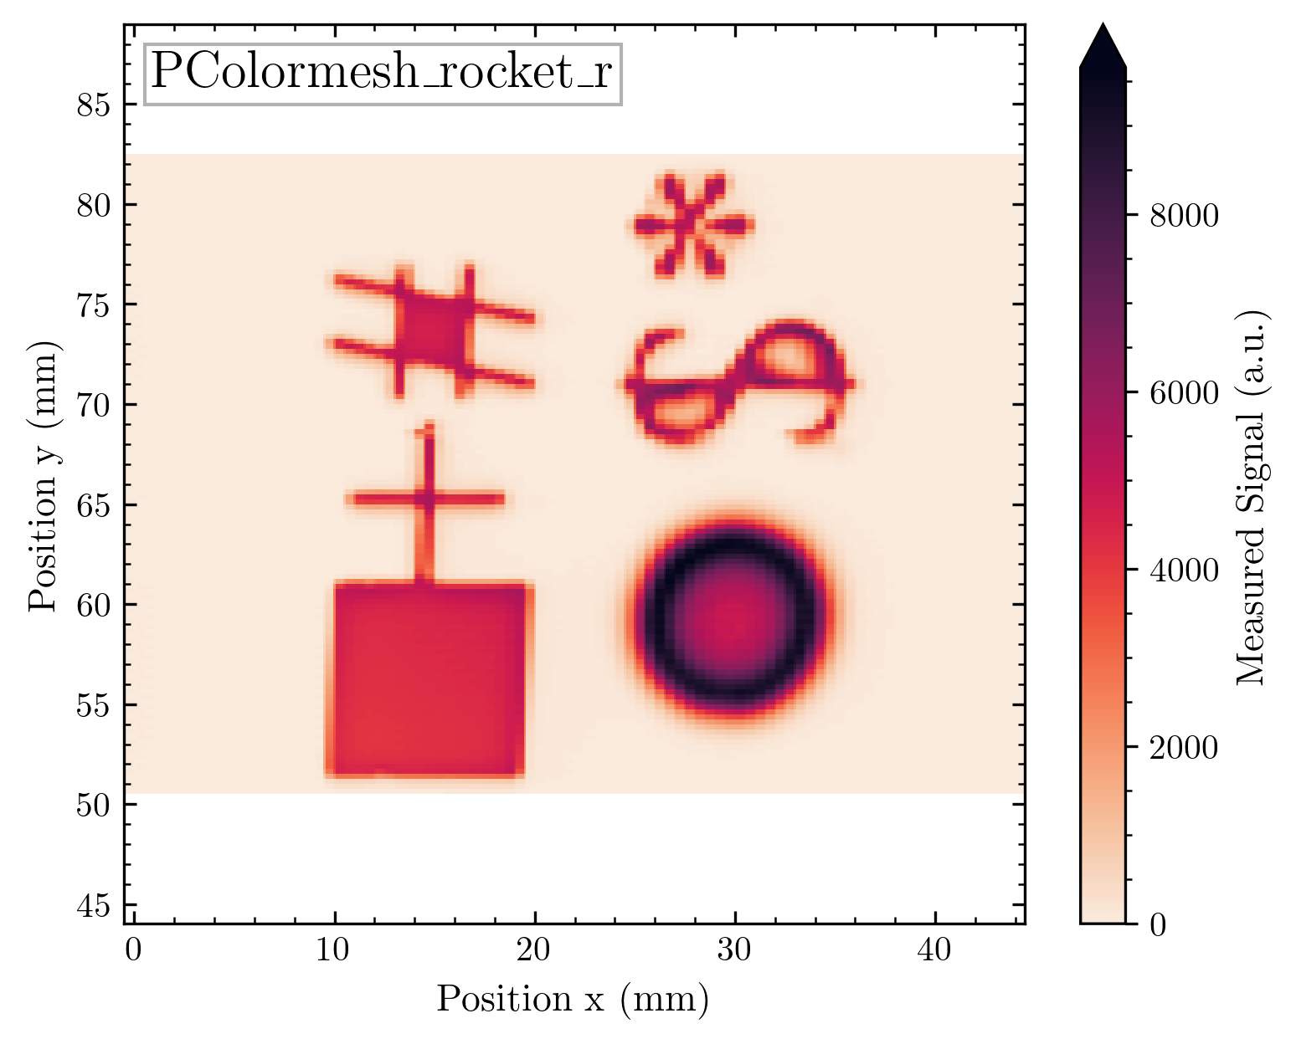
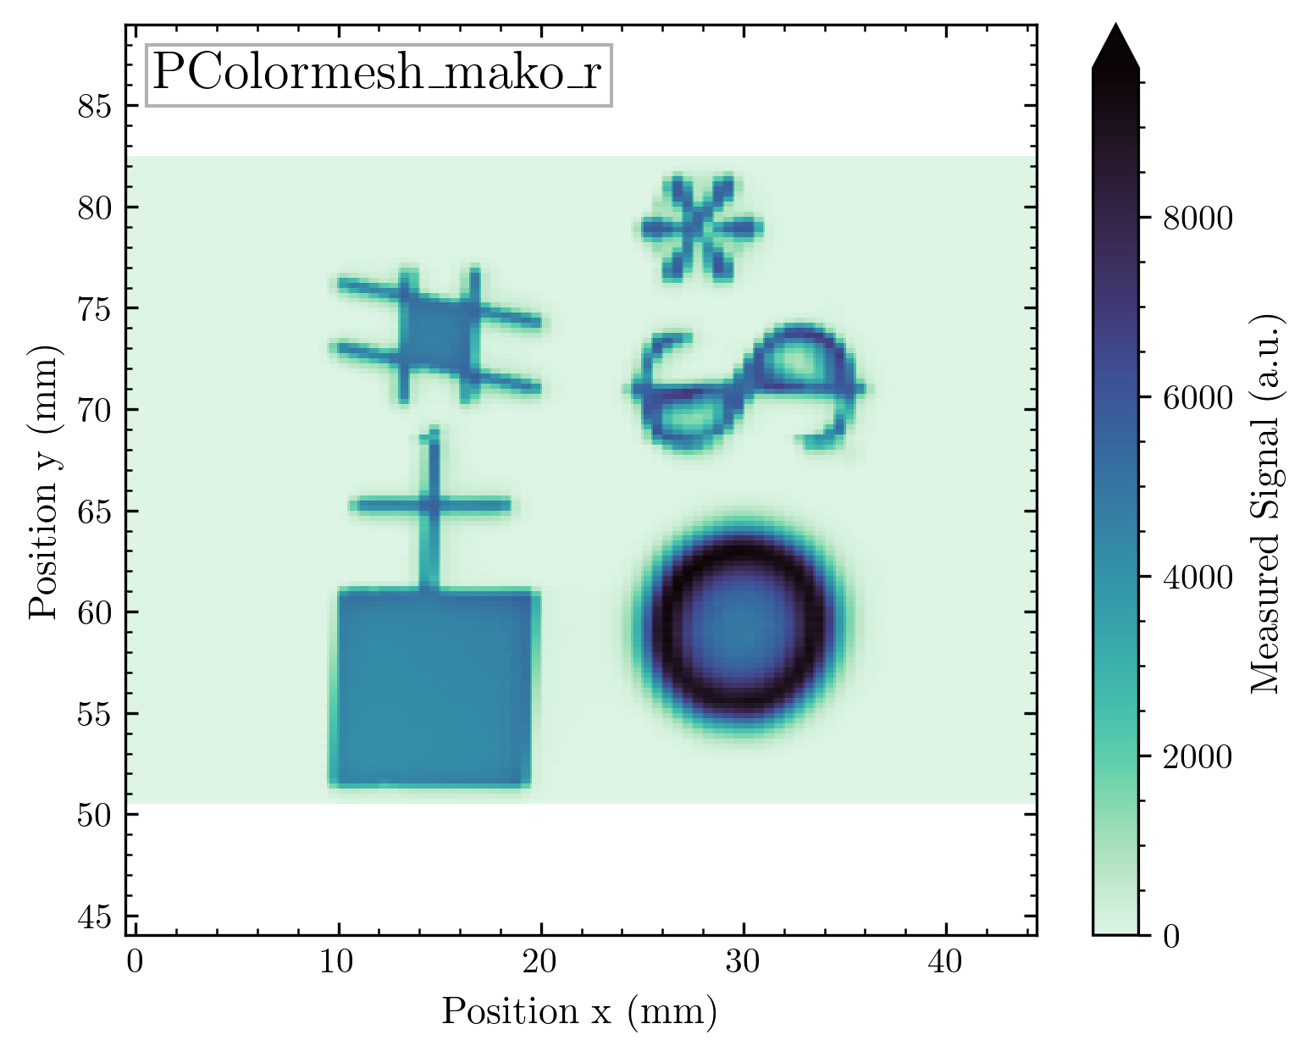

Slide 53
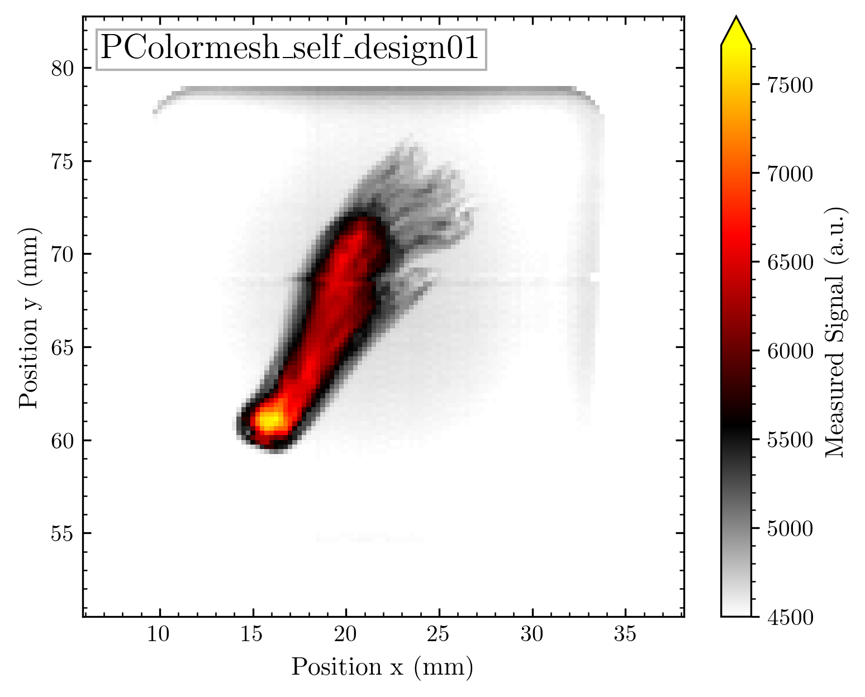
Mouse Foot – limited signal scale
There will be normal and _r = reversed versions of each map!
The self-designed colormap is not perfect here, but still good!

Slide 54
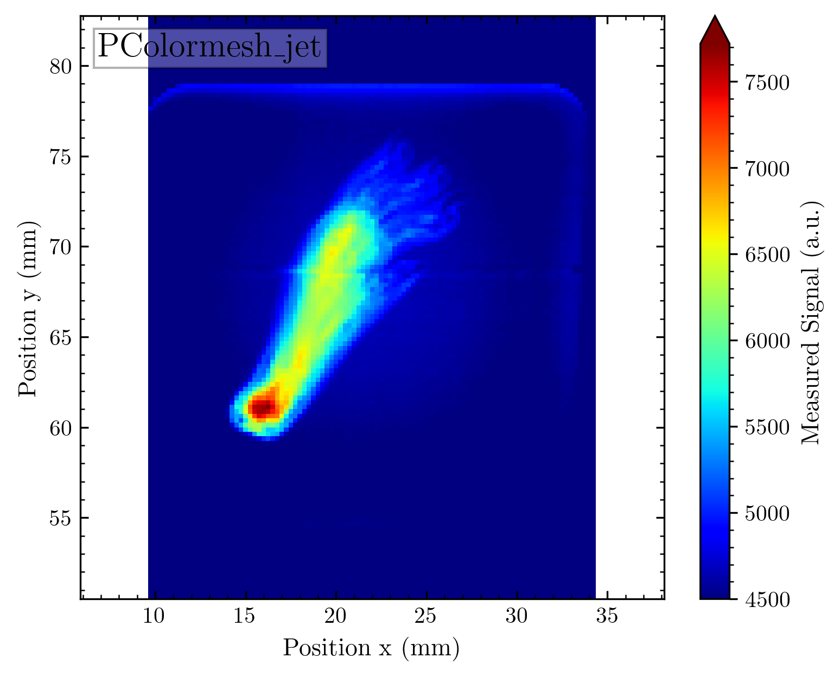
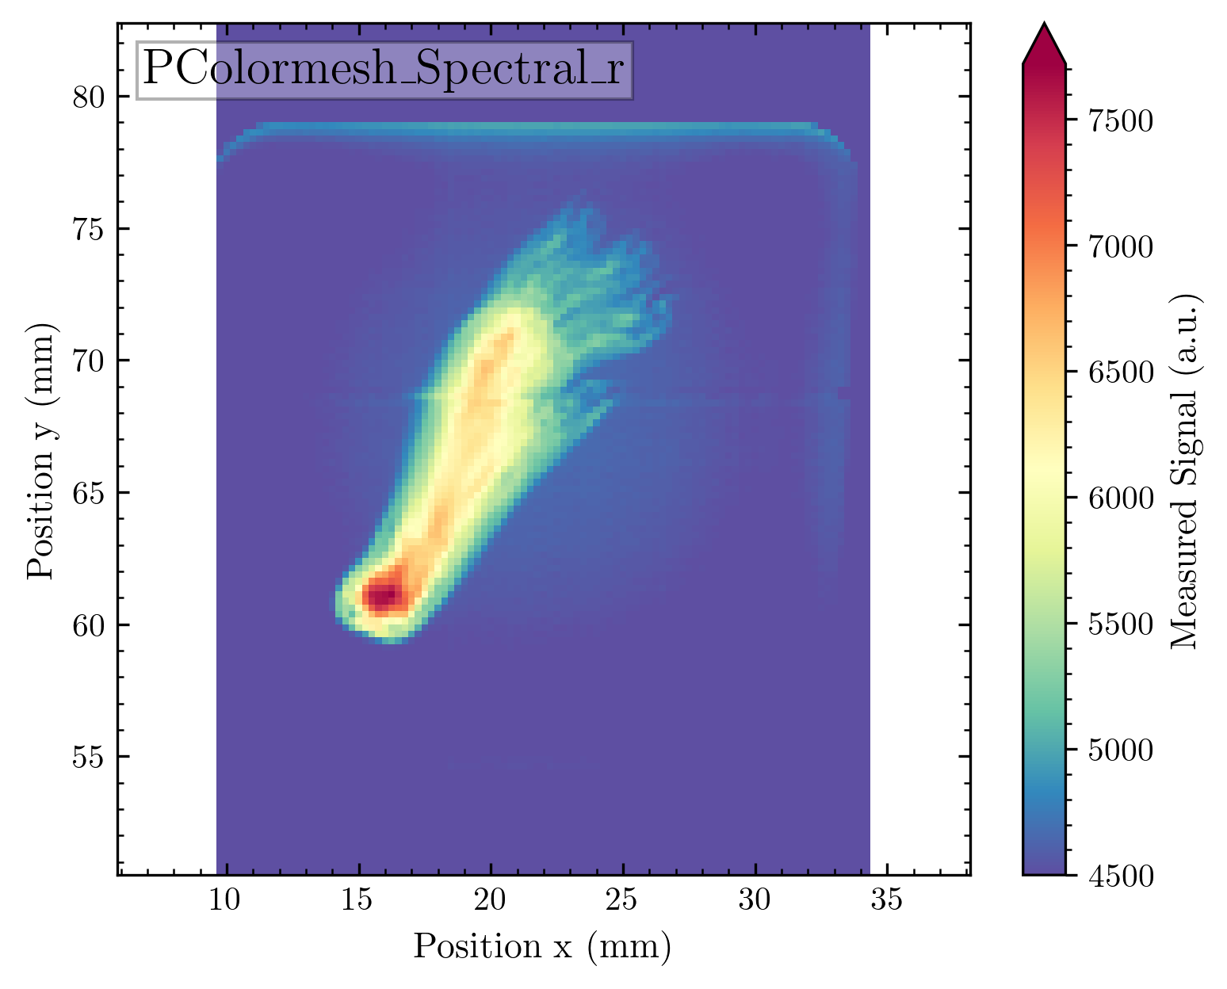

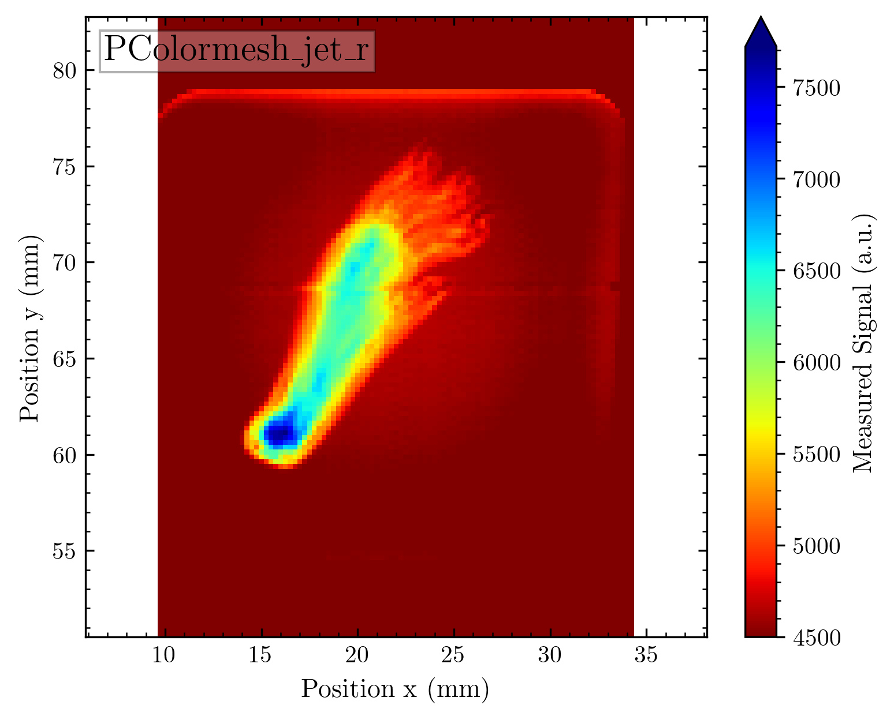
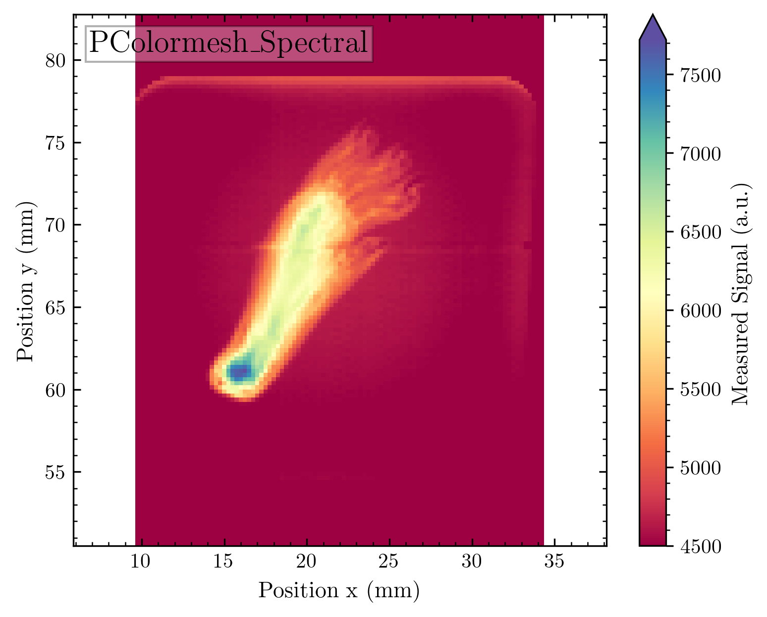
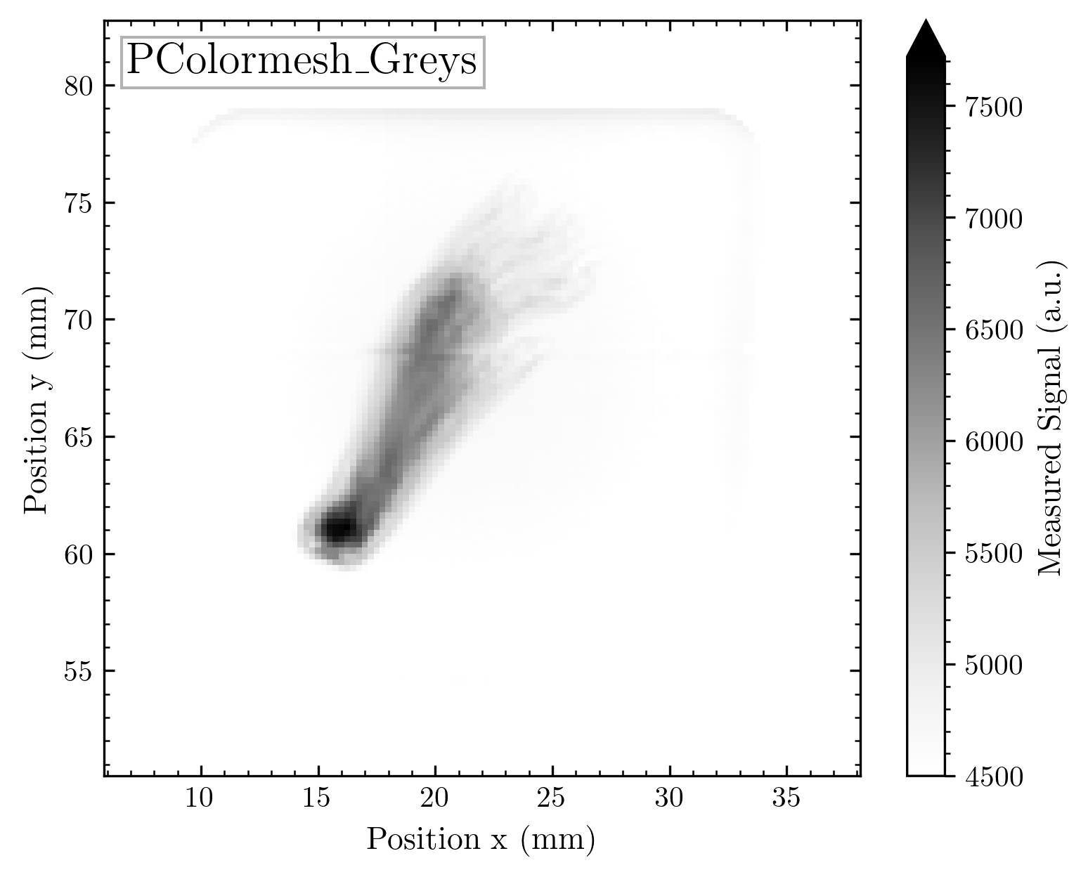

Slide 55







Slide 56







Slide 57







Slide 58

Undiffused beam
There will be normal and _r = reversed versions of each map!
Good to judge for high intensity variation

Slide 59







Slide 60







Slide 61







Slide 62







Slide 63

Diffused beam
There will be normal and _r = reversed versions of each map!
Good to judge for low intensity variation

Slide 64







Slide 65







Slide 66







Slide 67







Slide 68
Résumé
There are some reasonably good colormap choices
My design is already quite good over a large intensity scale but suffers from an unintuitive color scale
The quite popular jet is in my opinion unusable
Maybe different maps for different purposes?
X-ray style (Greys_r) for biological tissue is of course fancy
Rocket and Magma seem to be quite nice
Question which contrast should be preferred: Dark = low signal (maybe more intuitive?) or dark = high signal

